Slide 1






Enhanced environmental protection inspection for efficient control of air quality monitoring and of all entities under obligation within system of greenhouse gas emission allowance trading, in order to achieve better quality of air in Republic of Croatia
This project is funded by the European Union

Slide 2



TOPIC 15: Web reporting (benefits for target groups)
Energy research and Environmental Protection Institute
Predrag Hercog, B.Sc. Biochemistry
Senior lecturer
Place, xx.xx.201x.

Slide 3

15.1 REASONS FOR WEB REPORTING
European Union IPA 2013 Programme for Croatia
CAFE Directive 2008/50/EC, chapter INFORMING AND REPORTING, Articles 26. – 28.
Public informing- Article 26.
Member States shall ensure that the public, as well as relevant organizations such as environmental protection organizations, consumer protection organizations, organizations representing the interests of vulnerable groups of the population, other relevant health protection authorities and industrial associations are informed in an appropriate and timely manner on air quality and air quality improvement plans and programs.
Information must be made available free of charge through all easily available media, including the Internet or any other telecommunication medium.
Member States must allow public access to annual reports for all pollutants covered by the Directive. These reports represent a summary of levels that exceed limit values, target values, long-term goals, informing thresholds, and alert thresholds for relevant averaging periods.
Institut za energetiku i zaštitu okoliša
Energy Research and Environmental Protection Institute

Slide 4
15.1 REASONS FOR WEB REPORTING
European Union IPA 2013 Programme for Croatia
CAFE Directive 2008/50/EC, chapter INFORMING AND REPORTING, Articles 26. – 28.
Transmission of information and reporting - Article 27.
Member States shall ensure that information on air quality is available to the Commission within the prescribed time, as determined by implementing measures.
For the purposes of assessing compliance with the limit values and critical levels and achieving the target values, such information shall be submitted to the Commission not later than nine months after the end of each year.
Implementing measures - Article 28
The Commission also finds ways to streamline the dana submission and mutual exchange of information and data from networks and individual monitoring stations for the measurement of air pollution within Member States.
Institut za energetiku i zaštitu okoliša
Energy Research and Environmental Protection Institute

Slide 5
15.1 REASONS FOR WEB REPORTING
European Union IPA 2013 Programme for Croatia
PUBLIC INFORMING- Annex 16 of CAFE Directive
Member States shall ensure that updated information on concentrations of air pollutants covered by the CAFE Directive is regularly available to the public.
Information includes all levels that exceed the air quality targets, including limit values, target values, alert thresholds, informing thresholds, or long-term goals for pollutants defined by regulations. They also include a brief assessment of the air quality objectives and appropriate information on the effects on health or, where appropriate, vegetation.
Information on concentrations of sulfur dioxide, nitrogen dioxide, particulate matter (at least PM10), ground ozone and carbon monoxide in the air are updated at least once a day, and whenever possible every hour.
Information on concentrations of lead and benzene in the air, expressed as the average values ​​for the last 12 months, is updated every three months, and whenever possible, every month.
Institut za energetiku i zaštitu okoliša
Energy Research and Environmental Protection Institute

Slide 6
15.1 REASONS FOR WEB REPORTING
European Union IPA 2013 Programme for Croatia
Commission Implementing Decision IPR (2011/850/EU) - sets out the rules for Directives 2004/107 / EC and 2008/50 / EC with regard to mutual exchange of information and reporting on air quality.
The scope of this Decision covers annual reporting on air quality assessment and delivery of information on plans and programs.
The Decision also stipulates that the Commission, with the assistance of the European Environment Agency, should establish an Internet interface called the Air Quality Portal, where Member States should make available information on air quality and where the public will have access to environmental information published by Member States.Member States and the Commission must collect, exchange and evaluate the latest information on air quality to better understand the effects of air pollution and develop appropriate policies. In order to facilitate the processing and comparison of the latest air quality information, the most recent information should be made available to the Commission in the same standardized form as verified data, within a reasonable time after being made available to the public.
Institut za energetiku i zaštitu okoliša
Energy Research and Environmental Protection Institute

Slide 7
15.1 REASONS FOR WEB REPORTING
European Union IPA 2013 Programme for Croatia
The Ordinance on Air Quality Monitoring (OG 79/17) - also prescribes the manner of regular public informing.
PUBLIC INFORMING- Article 25
The Ministry, the Meteorological and Hydrological Service, the local and regional self-government units and the Agency shall ensure that the public as well as relevant organizations such as environmental protection organizations, consumer protection organizations, organizations representing the interests of vulnerable population groups, other relevant health protection authorities and industrial associations, are informed in an appropriate and timely manner on the available information as follows:
– concentrations of sulfur dioxide, nitrogen dioxide and particulate matter in the air are published daily, and in the case of hourly values for sulfur dioxide and nitrogen dioxide, every hour
Institut za energetiku i zaštitu okoliša
Energy Research and Environmental Protection Institute

Slide 8
15.1 REASONS FOR WEB REPORTING
European Union IPA 2013 Programme for Croatia
– benzene concentrations in the air, as the average values of the last 12 months, are published at least every three months and, if possible, every month
- concentrations of carbon monoxide in the air, as the highest eight-hour average, are published daily and, if possible, every hour
- concentrations of hydrogen sulphide in the air, are published every hour
- concentrations of ammonia in the air are published daily and / or every hour
- concentrations of ground-level ozone in air are reported daily as the highest eight-hour average, and if possible, every hour
- action plans for improving air quality, short-term action plans and the Air Protection Plan in accordance with the Air Protection Act..
This information is also published in a machine - readable form, together with other general information on air quality, on the Agency's website.
Institut za energetiku i zaštitu okoliša
Energy Research and Environmental Protection Institute

Slide 9
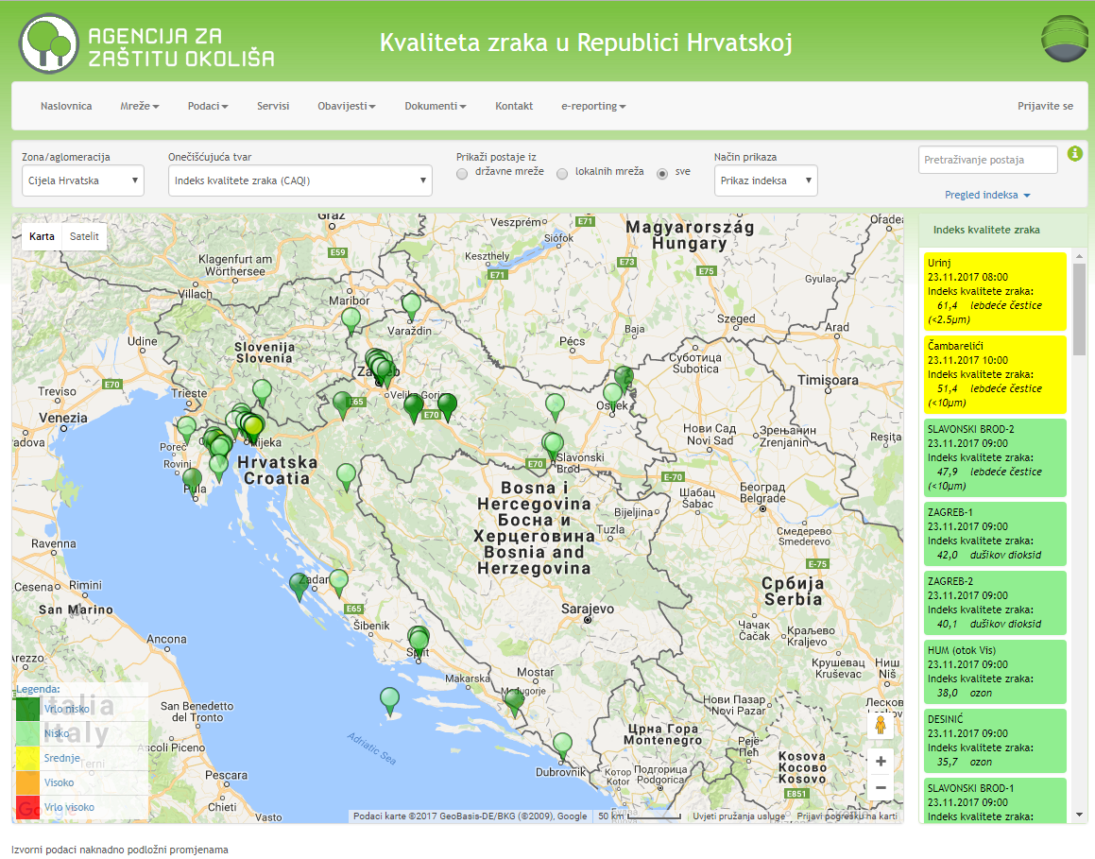
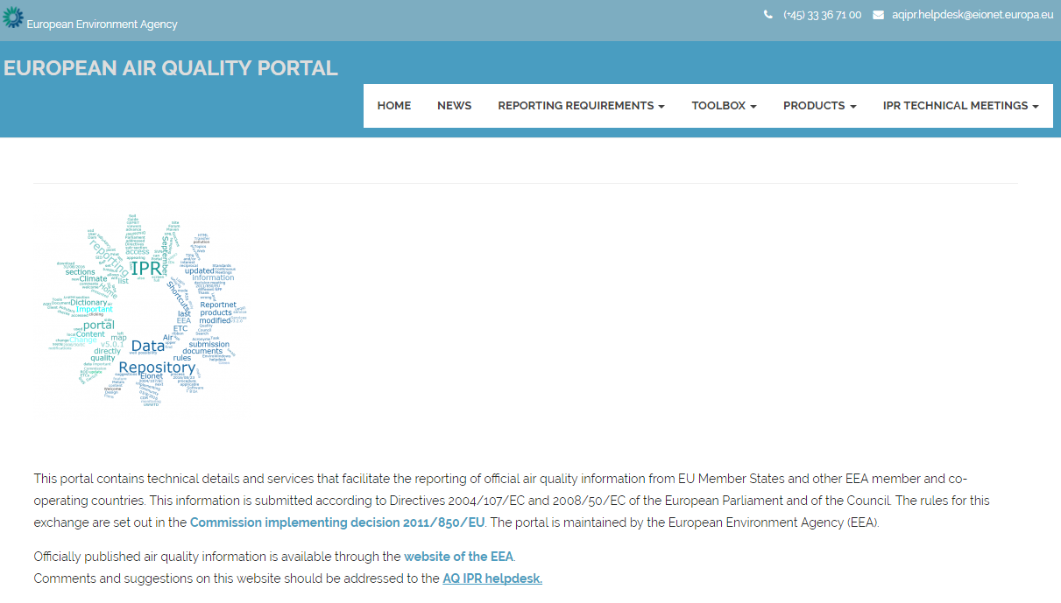
15.2 „NEAR REAL TIME” REPORTING
European Union IPA 2013 Programme for Croatia
Reporting "Near Real Time" (NRT) data (former name) or Up To Date (UTD) of data (new name) takes place every hour by transferring the .xml file with the air quality data from the portal "Air quality in the Republic of Croatia" to the European Air Quality Portal.
.xml
Institut za energetiku i zaštitu okoliša
Energy Research and Environmental Protection Institute

Slide 10
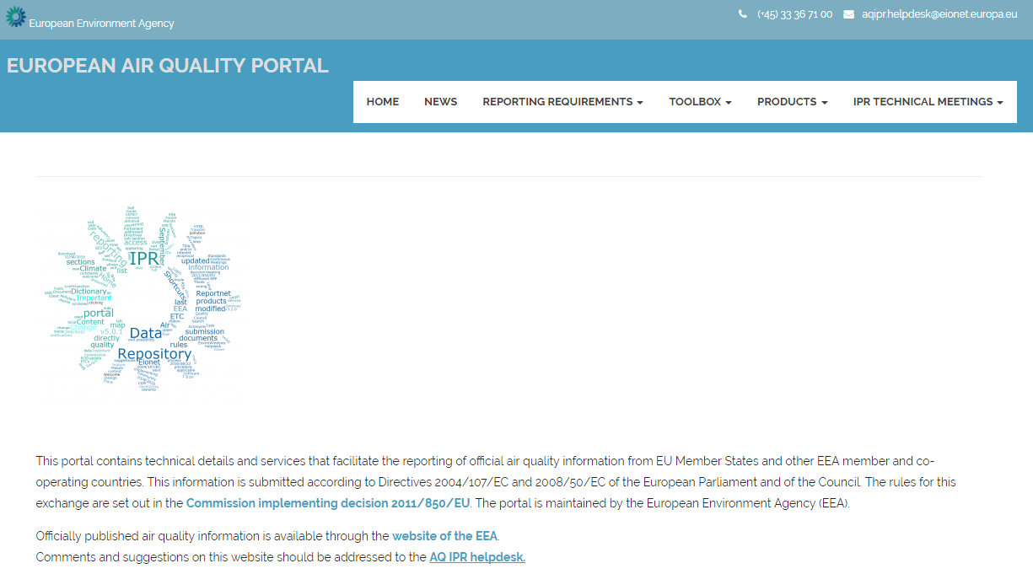
15.2 „NEAR REAL TIME” REPORTING
European Union IPA 2013 Programme for Croatia
Europen Air Quality Portal
The display of submitted UTD data is enabled via the browser / tool on the European Air Quality Portal, developed, maintained and managed by EEA
The portal contains browsers / tools that allow you to track the data delivery process and can be accessed through the menu bar in the PRODUCTS tab.
http://eeadmz1-cws-wp-air.azurewebsites.net/
Institut za energetiku i zaštitu okoliša
Energy Research and Environmental Protection Institute

Slide 11
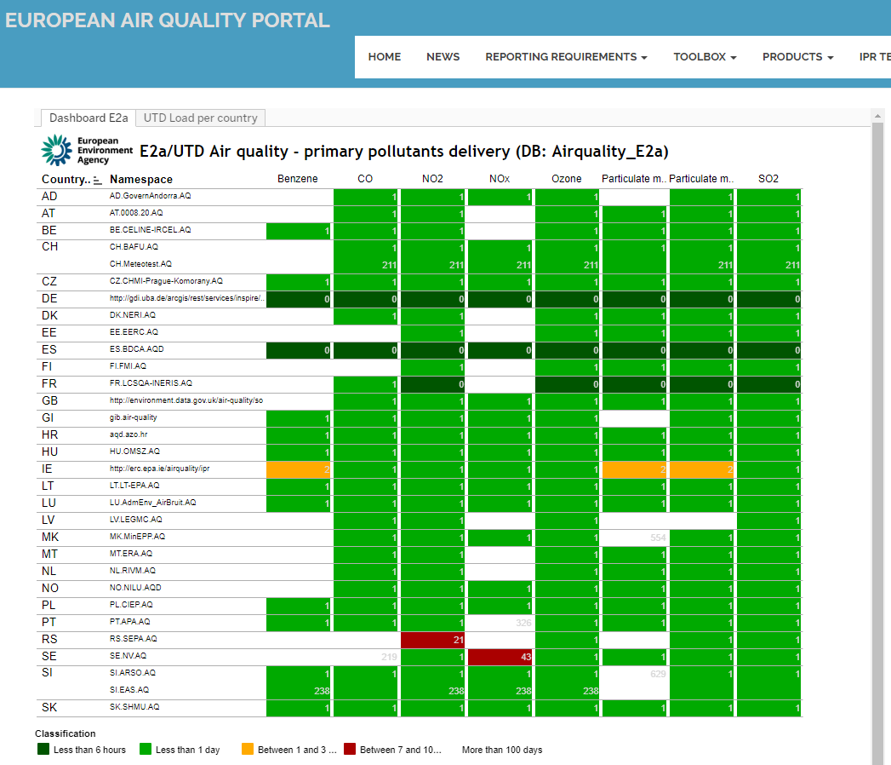
15.2 „NEAR REAL TIME” REPORTING
European Union IPA 2013 Programme for Croatia
UTD data delivery status
- For each country time of UTD data submission is shown for each pollutant in the tab: PRODUCTS / SUBMISSION MONITORING / DATA MONITOR-E2A (UTD)
http://eeadmz1-cws-wp-air.azurewebsites.net/products/submission-monitoring/data-submission-e2a-utd/
Institut za energetiku i zaštitu okoliša
Energy Research and Environmental Protection Institute

Slide 12
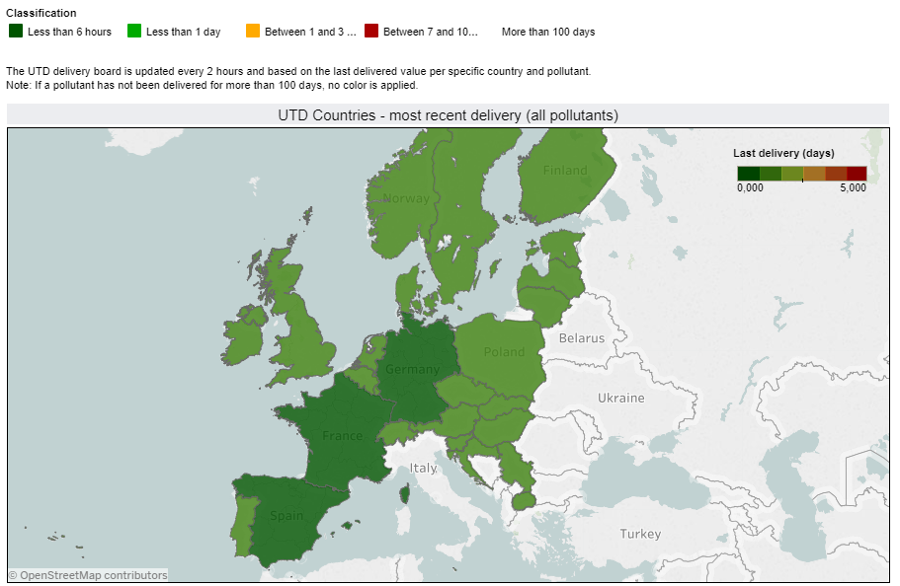
15.2 „NEAR REAL TIME” REPORTING
European Union IPA 2013 Programme for Croatia
UTD data delivery status
The same is shown on the map - for all pollutants
http://eeadmz1-cws-wp-air.azurewebsites.net/products/submission-monitoring/data-submission-e2a-utd/
Institut za energetiku i zaštitu okoliša
Energy Research and Environmental Protection Institute

Slide 13
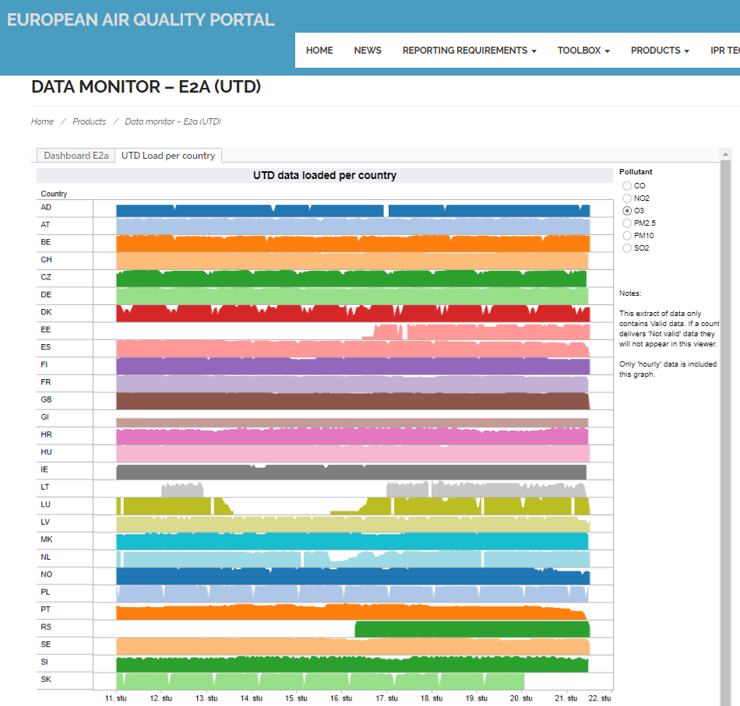
15.2 „NEAR REAL TIME” REPORTING
European Union IPA 2013 Programme for Croatia
UTD data delivery status
The quantity of submitted UTD data is also graphically displayed - for each country for each pollutant
http://eeadmz1-cws-wp-air.azurewebsites.net/products/submission-monitoring/data-submission-e2a-utd/
Institut za energetiku i zaštitu okoliša
Energy Research and Environmental Protection Institute

Slide 14
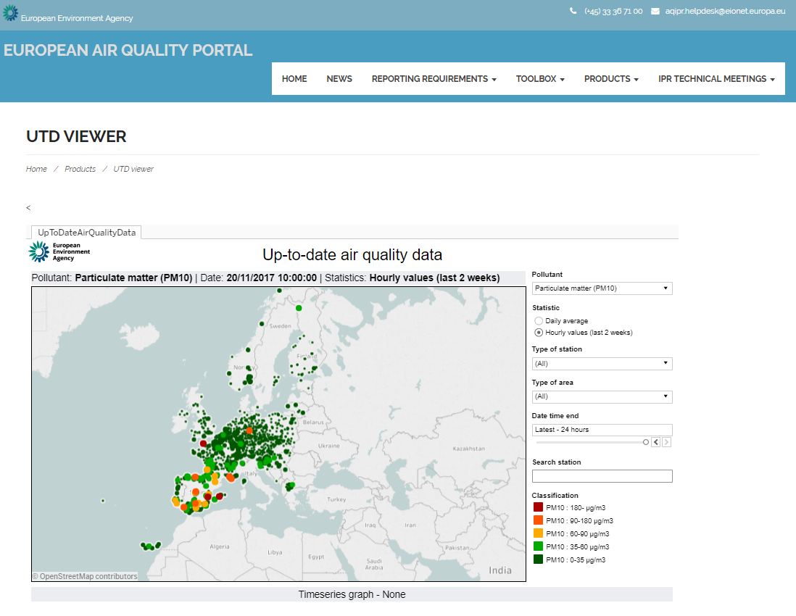
15.2 „NEAR REAL TIME” REPORTING
European Union IPA 2013 Programme for Croatia
UTD data
can be viewed on the browser in the tab: PRODUCTS / DATA VIEWERS / UTD VIEWERS :
The UTD data can be browsed by pollutant, averaging time and type of station and area
http://eeadmz1-cws-wp-air.azurewebsites.net/products/data-viewers/utd-viewer/
Institut za energetiku i zaštitu okoliša
Energy Research and Environmental Protection Institute

Slide 15
15.3 WEB REPORTING OF VALIDATED AND NON-VALIDATED DATA
European Union IPA 2013 Programme for Croatia
Data viewing via the Internet (web) is enabled via the browser / tool on the European Air Quality Portal, which is developed, maintained and managed by EEA
http://eeadmz1-cws-wp-air.azurewebsites.net/
The available browsers / tools allow you tracking the data submission process and can be accessed through the menu bar in the PRODUCTS tab.
Institut za energetiku i zaštitu okoliša
Energy Research and Environmental Protection Institute

Slide 16
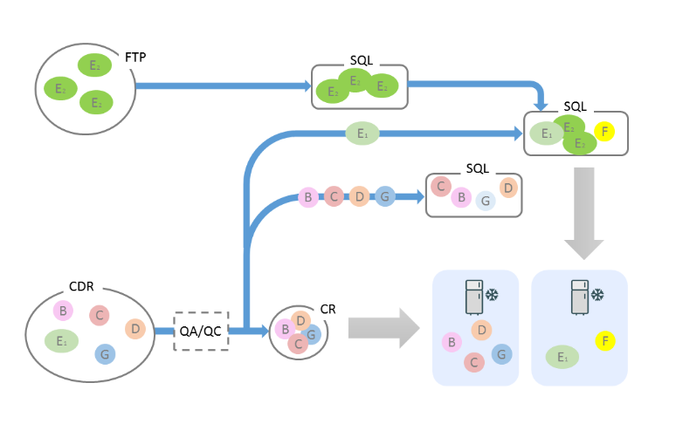
15.3 WEB REPORTING OF VALIDATED AND NON-VALIDATED DATA
European Union IPA 2013 Programme for Croatia
Europen Air Quality Portal
Different streams of data are shown in the picture. Submitted data is used as a data source in browsers
E2a data (UTD) – are submitted via FTP server every hour
Other data (B-G) are delivered to CDR after they have passed QA/QC checks
Institut za energetiku i zaštitu okoliša
Energy Research and Environmental Protection Institute

Slide 17
15.3 WEB REPORTING OF VALIDATED AND NON-VALIDATED DATA
European Union IPA 2013 Programme for Croatia
Browsers / Tools can be divided into four categories (available from the menu bar):
Browsers that enable monitoring the data submission status in the EEA.
AIDE tables - Display the submitted data B to G and information supplied with data B to G.
Data Browsers – Allow data and statistical data viewing contained in the EEA databases and their display on maps, charts, or tables.
Data download - special tools allow data download contained in EEA databases. It mainly relates to E1a and E2a data plus a part of meta-data and geometry of zones and agglomerations. Data can be downloaded using the download button that appears at the bottom of the dashboard.
In each browser, different data sets can be selected using filters that are usually displayed on the right side of the dashboard displayed. Some data can also be selected directly from maps.
Institut za energetiku i zaštitu okoliša
Energy Research and Environmental Protection Institute

Slide 18
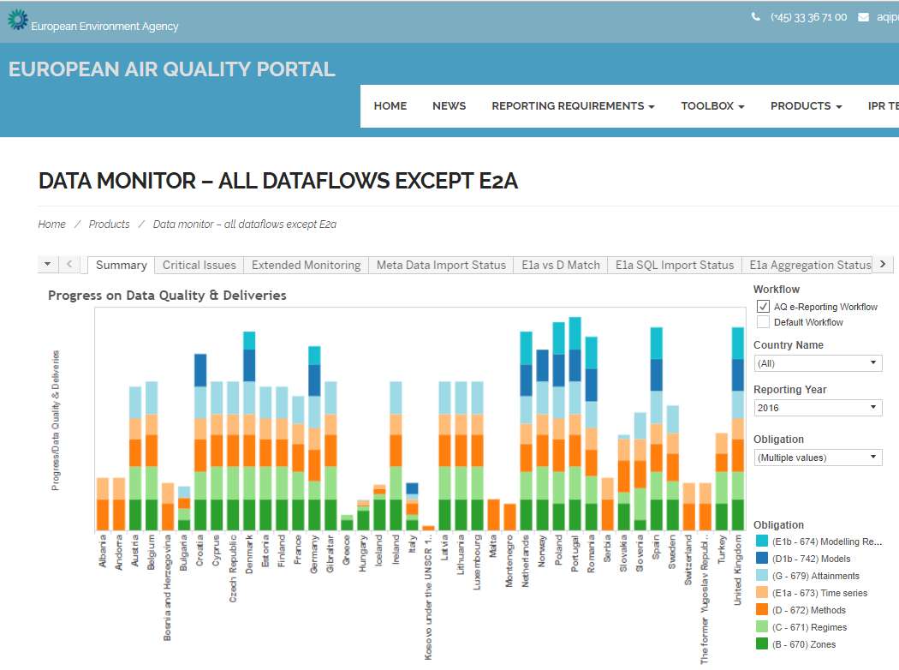
15.3 WEB REPORTING OF VALIDATED AND NON-VALIDATED DATA
European Union IPA 2013 Programme for Croatia
Submitted data browser
This browser shows how much data is delivered (B-G)
- excluding E2a data (UTD) - the status of UTD data is displayed on another browser
http://eeadmz1-cws-wp-air.azurewebsites.net/products/submission-monitoring/data-monitor-all-except-e2a/
Institut za energetiku i zaštitu okoliša

Slide 19
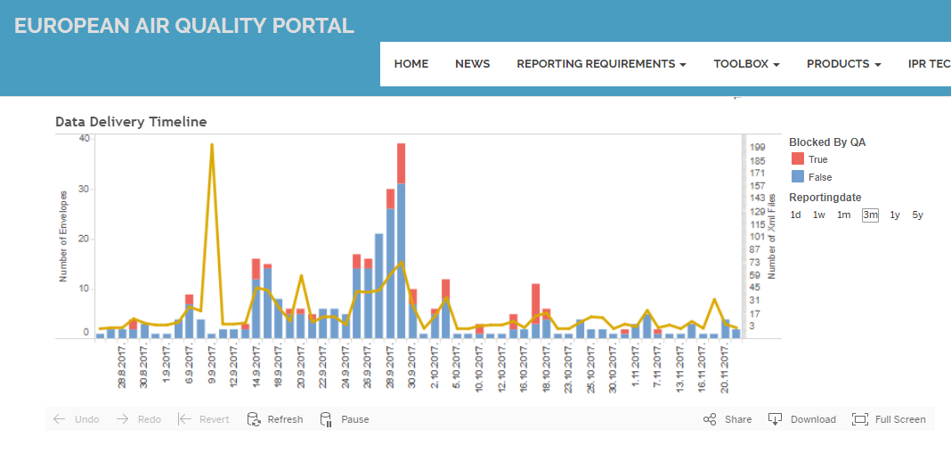
15.3 WEB REPORTING OF VALIDATED AND NON-VALIDATED DATA
European Union IPA 2013 Programme for Croatia
Submitted data browser– shows the amount and submission time of data
http://eeadmz1-cws-wp-air.azurewebsites.net/products/submission-monitoring/data-monitor-all-except-e2a/
Institut za energetiku i zaštitu okoliša
Energy Research and Environmental Protection Institute

Slide 20
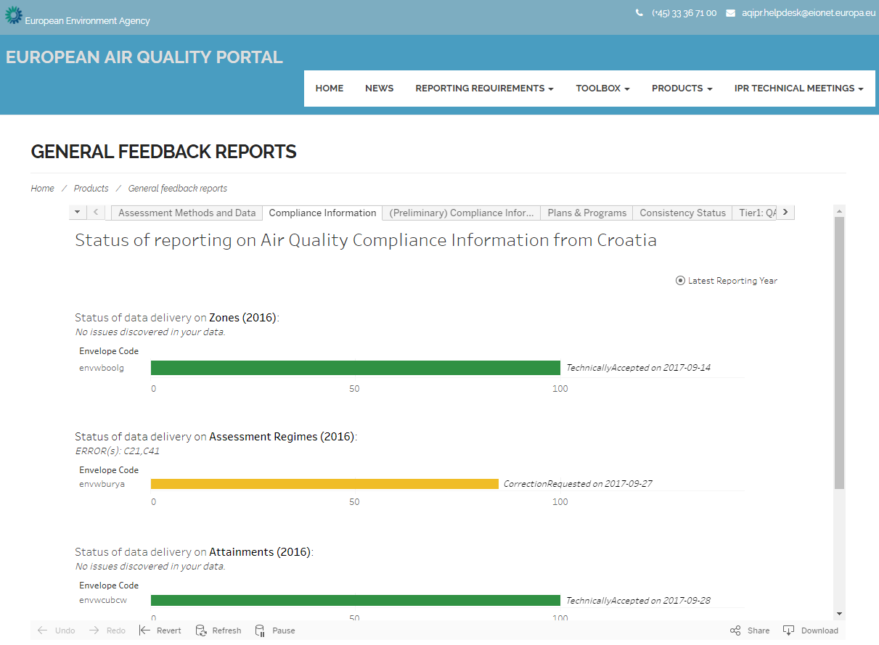
15.3 WEB REPORTING OF VALIDATED AND NON-VALIDATED DATA
European Union IPA 2013 Programme for Croatia
Feedback on data submission
These browsers / tools provide a quick overview of the most recent data submission: envelope status, QA / QC master messages in CDR (Tier 1 checks), and additional information on data quality check after and outside CDR (Tier 2 checks).
Reports are still in trial beta versions
http://eeadmz1-cws-wp-air.azurewebsites.net/products/feedback-on-submissions/general-feedback/feedback-reports/?CountryNameParameter=Croatia
Institut za energetiku i zaštitu okoliša
Energy Research and Environmental Protection Institute

Slide 21
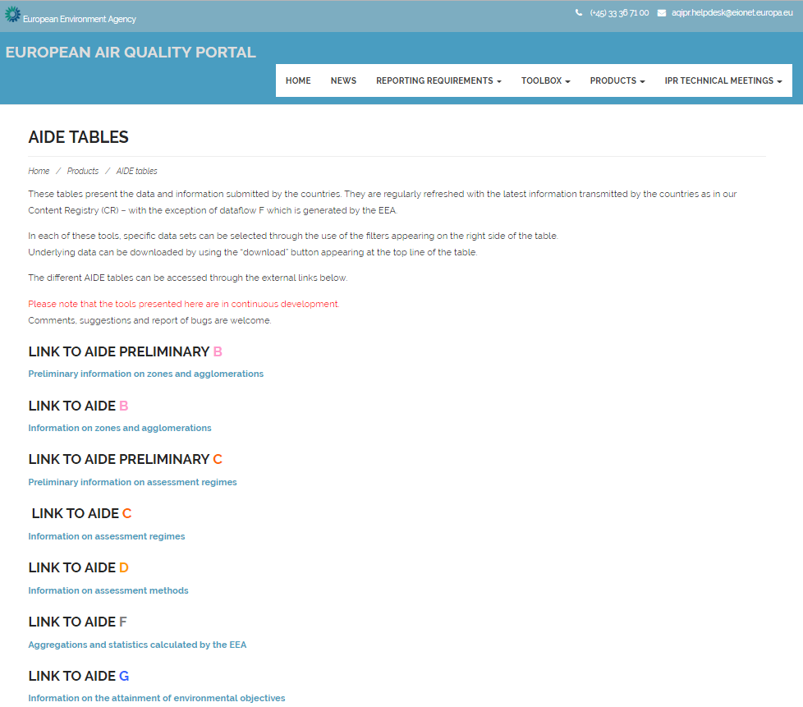
15.3 WEB REPORTING OF VALIDATED AND NON-VALIDATED DATA
European Union IPA 2013 Programme for Croatia
AIDE tables
display the data and information provided by countries and are regularly refreshed with the latest information.
Each of these tables alllow selection of specific data sets with filters that appear on the right of the table
You can download the data using the "download" button that appears in the top line of the table.
http://eeadmz1-cws-wp-air.azurewebsites.net/products/aide-tables/
Institut za energetiku i zaštitu okoliša
Energy Research and Environmental Protection Institute

Slide 22
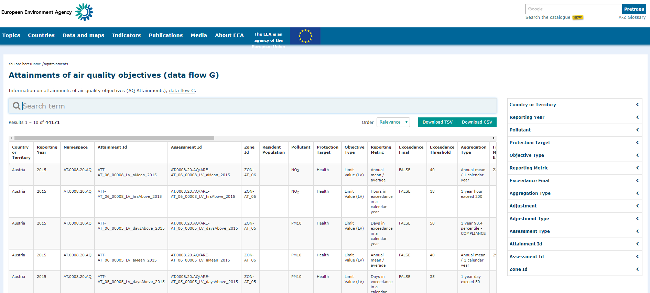
15.3 WEB REPORTING OF VALIDATED AND NON-VALIDATED DATA
European Union IPA 2013 Programme for Croatia
AIDE tables - filters are on the right of the table, and the data can be downloaded with the "download" button.
http://aideg.apps.eea.europa.eu/?source=%7B%22query%22%3A%7B%22match_all%22%3A%7B%7D%7D%2C%22display_type%22%3A%22tabular%22%7D
Institut za energetiku i zaštitu okoliša
Energy Research and Environmental Protection Institute

Slide 23
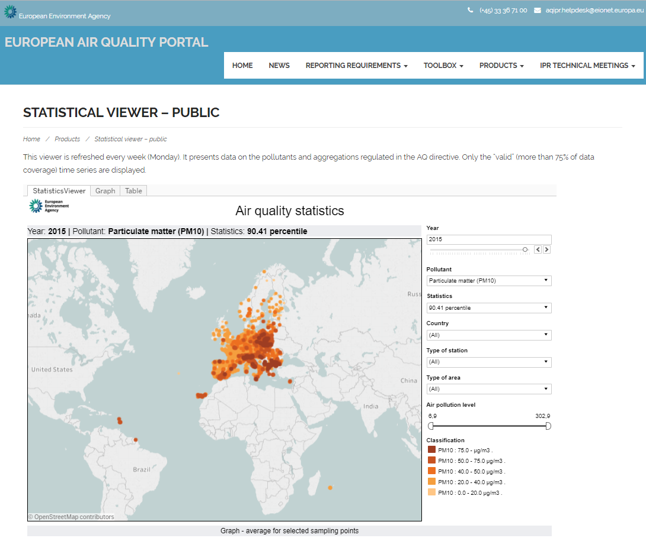
15.3 WEB REPORTING OF VALIDATED AND NON-VALIDATED DATA
European Union IPA 2013 Programme for Croatia
Statistics of validated data on the EEA AQ Portal
Year, pollutant and statistical parameter can be chosen on the right side of the table- values for the whole Europe are shown
Search can also be narrowed down to a particular country, type of station, and type of area.
http://eeadmz1-cws-wp-air.azurewebsites.net/products/data-viewers/statistical-viewer-public/
Institut za energetiku i zaštitu okoliša
Energy Research and Environmental Protection Institute

Slide 24
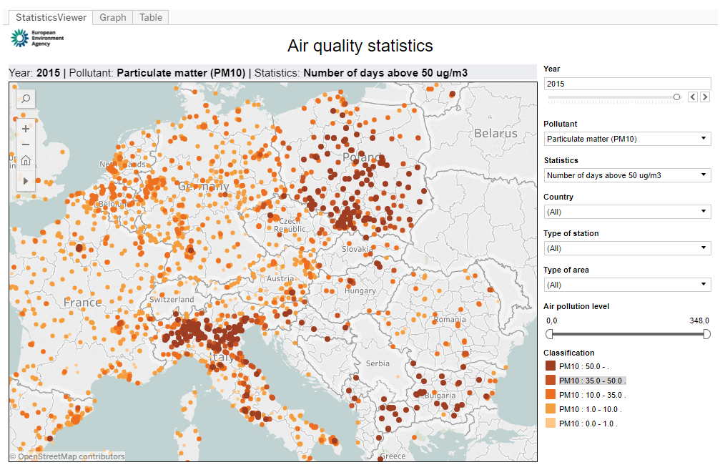
15.3 WEB REPORTING OF VALIDATED AND NON-VALIDATED DATA
European Union IPA 2013 Programme for Croatia
Any area can be zoomed, and placing the cursor at any point of measurement will show the baseline data of the station and in this case the number of GV exceedance days.
http://eeadmz1-cws-wp-air.azurewebsites.net/products/data-viewers/statistical-viewer-public/
Institut za energetiku i zaštitu okoliša
Energy Research and Environmental Protection Institute

Slide 25
15.4 REPORTING BY AIR QUALITY INDEX
European Union IPA 2013 Programme for Croatia
AIR QUALITY INDEX
Making the index is a pragmatic process of reducing the variety of information on chemical features of a fairly complex blend of pollutants in the air to a simple image on a scale.
From a scientific point of view, this is a rough generalization and a huge loss of information, but for communication purposes this reduction in information is considered essential.
How to reduce complex information largely depends on the purpose for which the index should be used. There are many ways of making / displaying the air quality index, and one of the ways is not necessarily better than the other.
The exact formula for the transmission of concentrations readings into the index classes is another thing of subjective choices, though limit values (for example, those deriving from air quality regulations such as Directive 2008/50 / EC) are often used as guidelines.
Institut za energetiku i zaštitu okoliša
Energy Research and Environmental Protection Institute

Slide 26
15.4 REPORTING BY AIR QUALITY INDEX
European Union IPA 2013 Programme for Croatia
AIR QUALITY INDEX
There are several reasons for creating an index:
Linking air quality with effects on health to inform the public about air quality and possible corrective measures;
compressing a large number of complex data - simpler review of information (e.g. for policy development or standard compliance verification);
attracting public attention to air quality issues and raising awareness.
Linking information on air quality with influences on health is a potentially very powerful way of communicating and as a health concern of every individual is mostly very convincing. Although the health-based index has some drawbacks, it can be said that it is important to warn people of unfavorable air quality.
Institut za energetiku i zaštitu okoliša
Energy Research and Environmental Protection Institute

Slide 27
15.4 REPORTING BY AIR QUALITY INDEX
European Union IPA 2013 Programme for Croatia
AIR QUALITY INDEX
Compressing a large number of complex data - providing simple clear information for formulation or policy monitoring, if consistently applied, can indicate progress or stagnation.
Attracting the public's attention to air quality issues and raising awareness - short-term indexes on the website are used to alert the public to air quality and raise awareness – they inform or alert the public because the public is affected by air pollution particularly in urban areas.
Institut za energetiku i zaštitu okoliša
Energy Research and Environmental Protection Institute

Slide 28
15.4 REPORTING BY AIR QUALITY INDEX
European Union IPA 2013 Programme for Croatia
AIR QUALITY INDEX
- CAQI - Common Air Quality Index
CAQI was developed during the CITEAIR II project
http://www.citeair.eu/
and is used on the website www.airqualitynow.eu since 2006.
WHY CAQI
CAQI is designed to compare air quality in European cities in real time.
At the beginning of the CITEAIR project it was noted that many cities show air quality in different, hardly comparable ways, often using their own (or sometimes nationally prescribed) air quality index.
The problem was that all the indexes were different in logic and presentation.
Institut za energetiku i zaštitu okoliša
Energy Research and Environmental Protection Institute

Slide 29
15.4 REPORTING BY AIR QUALITY INDEX
European Union IPA 2013 Programme for Croatia
CAQI - Common Air Quality Index
Index (CAQI) has been developed to exist with current indexes and could be used to compare air quality in cities on the web site; it was not intended to replace existing indices.
It was part of an effort to raise awareness of air quality in cities.
Since the launch of CAQI, the Air Quality Directive (CAFE Directive 2008 / 50EU) has been revised, with the PM_{2.5} limit value added.
Since PM_{2.5} is probably the most important parameter for air quality in urban areas in Europe today, it is included subsequently in the CAQI calculation.
Display of air quality parameters by CAQI is also available on the "Air Quality in Croatia" portal http://iszz.azo.hr/iskzl/index.html since 2014.
Institut za energetiku i zaštitu okoliša
Energy Research and Environmental Protection Institute

Slide 30
15.4 REPORTING BY AIR QUALITY INDEX
European Union IPA 2013 Programme for Croatia
Air quality index on the portal The air quality in Croatia consists of five levels (different coloring) ranging from 0 (very low) to >100 (very high) and it is a relative measure of air pollution. Lower index values (levels) indicate cleaner air.
The index value depends on the concentrations of six pollutants: nitrogen dioxide (NO₂), sulfur dioxide (SO₂), ozone (O₃), floating particles PM₁₀ and PM_{2.5} and carbon monoxide (CO) according to the European Common Air Quality Index (CAQI) .
For each pollutant the index is calculated based on the measured hourly concentration.
The total index is the highest index of any pollutant at a given moment, at an individual air quality monitoring station.
Institut za energetiku i zaštitu okoliša
Energy Research and Environmental Protection Institute

Slide 31
15.4 REPORTING BY AIR QUALITY INDEX
European Union IPA 2013 Programme for Croatia
CAQI - Common Air Quality Index - index levels, colors and pollutants included in index calculation
POLLUTION | INDEKS RANGE | POLLUTANT CONCENTRATIONS (µg/m³)
 |  | NO₂ | PM₁₀ |  | O₃ | PM_{2.5} |  | CO | SO₂
 |  | 1 hour | 1 hour | 24 hours | 1 hour | 1 hour | 24 hours | 8-hour | 1 hour
VERY HIGH | >100 | >400 | >180 | >100 | >240 | >110 | >60 | >20000 | >500
HIGH | 100 | 400 | 180 | 100 | 240 | 110 | 60 | 20000 | 500
 | 75 | 200 | 90 | 50 | 180 | 55 | 30 | 10000 | 350
MEDIUM | 75 | 200 | 90 | 50 | 180 | 55 | 30 | 10000 | 350
 | 50 | 100 | 50 | 30 | 120 | 30 | 20 | 7500 | 100
LOW | 50 | 100 | 50 | 30 | 120 | 30 | 20 | 7500 | 100
 | 25 | 50 | 25 | 15 | 60 | 15 | 10 | 5000 | 50
VERY LOW | 25 | 50 | 25 | 15 | 60 | 15 | 10 | 5000 | 50
 | 0 | 0 | 0 | 0 | 0 | 0 | 0 | 0 | 0
Institut za energetiku i zaštitu okoliša

Slide 32
15.4 REPORTING BY AIR QUALITY INDEX
European Union IPA 2013 Programme for Croatia
NEW EUROPEAN AIR QUALITY INDEX
The new European air quality index was published in November 2017.
The new European Air Quality Index has been jointly developed by the European Commission's Directorate General for Environment and the European Environment Agency (EEA) to inform citizens and public authorities about air quality status across Europe.
The index points to the short-term air quality situation of more than two thousand air quality monitoring stations across Europe, using updated data provided by EEA member states.
https://www.eea.europa.eu/highlights/european-air-quality-index-current
http://www.eea.europa.eu/themes/air/air-quality-index
Institut za energetiku i zaštitu okoliša
Energy Research and Environmental Protection Institute

Slide 33
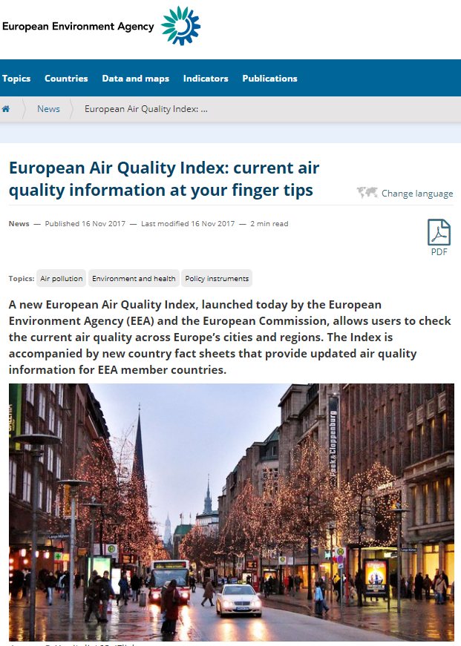
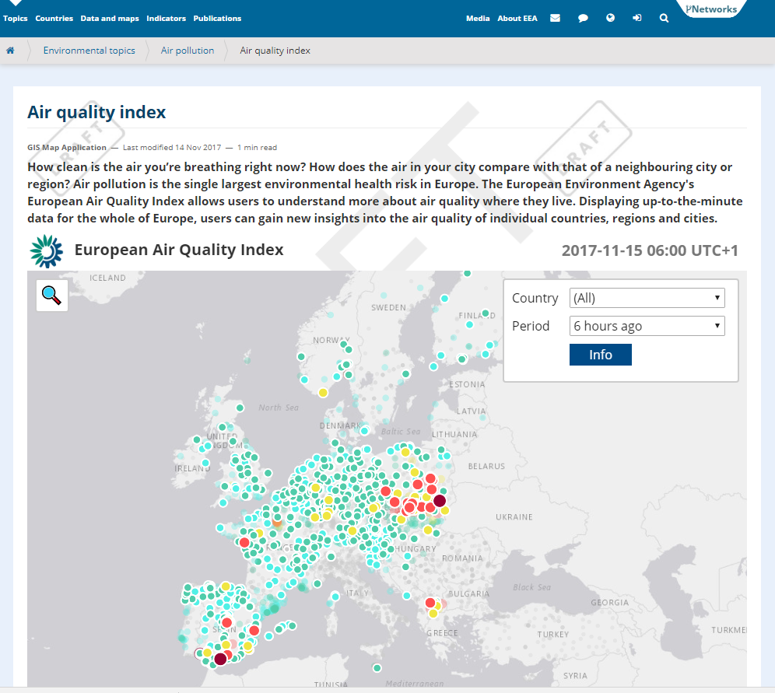
15.4 REPORTING BY AIR QUALITY INDEX
European Union IPA 2013 Programme for Croatia
NEW EUROPEAN AIR QUALITY INDEX
https://www.eea.europa.eu/highlights/european-air-quality-index-current
http://www.eea.europa.eu/themes/air/air-quality-index
Institut za energetiku i zaštitu okoliša
Energy Research and Environmental Protection Institute

Slide 34
15.4 REPORTING BY AIR QUALITY INDEX
European Union IPA 2013 Programme for Croatia
The European Air Quality Index gives users a better understanding of the current air quality in which they live, work or travel. By displaying updated information for the whole of Europe, users can gain insight into air quality in single countries, regions, and cities.
It was found that the main pollutants for index calculation are (AQI) O₃, NO₂, PM₁₀ and PM_{2.5}. It is calculated by comparing the index value for each of the individual pollutants, taking the worst (maximum) index value.
SO₂ values are included in the measured index, if available.
The current value of the index does not reflect the average annual air quality situation that can be significantly different.
Institut za energetiku i zaštitu okoliša
Energy Research and Environmental Protection Institute

Slide 35
15.4 REPORTING BY AIR QUALITY INDEX
European Union IPA 2013 Programme for Croatia
Since often a small number of pollutants is measured at air quality monitoring stations, the index is only calculated for those busy stations that measure both NO₂ and PM (ie. PM_{2.5} or PM₁₀ or both).
At all other air quality monitoring stations, the index is calculated for those stations measuring at least three pollutants NO₂, O₃ and PM (ie. PM_{2.5} or PM₁₀ or both).
The total index for a monitoring station or air quality forecast is updated every hour, and if the data is not recorded for a particular hour, the values are approximated ("filling in the gap") using CAMS modeled air quality data and in such cases are clearly marked within the index as 'modeled data'.
Institut za energetiku i zaštitu okoliša
Energy Research and Environmental Protection Institute

Slide 36
15.4 REPORTING BY AIR QUALITY INDEX
European Union IPA 2013 Programme for Croatia
EUROPEAN AIR QUALITY INDEX
Measurements up to five key pollutants supplemented with modeled data determine the index level that describes the current air quality situation at each monitoring station. The overall index corresponds to the poorest index level for any of the five pollutants according to the following scheme:
Pollutant |  |  | Particles smaller than 2.5 µm (PM_{2.5}) | Particles smaller than 10 µm (PM₁₀) | Nitrogen dioxide (NO₂) | Ozone (O₃) | Sulfur dioxide (SO₂)
Index level | (based on pollutant concentrations in μg / m³) | Good | 0-10 | 0-20 | 0-40 | 0-80 | 0-100
 |  | Acceptable | 10-20 | 20-35 | 40-100 | 80-120 | 100-200
 |  | Moderate | 20-25 | 35-50 | 100-200 | 120-180 | 200-350
 |  | Poor | 25-50 | 50-100 | 200-400 | 180-240 | 350-500
 |  | Very poor | 50-800 | 100-1200 | 400-1000 | 240-600 | 500-1250
Institut za energetiku i zaštitu okoliša
Energy Research and Environmental Protection Institute

Slide 37
15.4 REPORTING BY AIR QUALITY INDEX
European Union IPA 2013 Programme for Croatia
Pollutant |  |  | Particles smaller than 2.5 µm (PM_{2.5}) | Particles smaller than 10 µm (PM₁₀) | Nitrogen dioxide (NO₂) | Ozone (O₃) | Sulfur dioxide (SO₂)
Index level | (based on pollutant concentrations in μg / m³) | Good | 0-10 | 0-20 | 0-40 | 0-80 | 0-100
 |  | Acceptable | 10-20 | 20-35 | 40-100 | 80-120 | 100-200
 |  | Moderate | 20-25 | 35-50 | 100-200 | 120-180 | 200-350
 |  | Poor | 25-50 | 50-100 | 200-400 | 180-240 | 350-500
 |  | Very poor | 50-800 | 100-1200 | 400-1000 | 240-600 | 500-1250
The index is not calculated for air quality measurements that exceed the maximum value shown in the category 'very poor'. Measurements that are higher than those values are usually incorrect and in such cases marked as "no data" with a note, further analysis is required.
The PM₁₀ and PM_{2.5} values are based on 24-hour movable averages.
Institut za energetiku i zaštitu okoliša
Energy Research and Environmental Protection Institute

Slide 38
15.4 REPORTING BY AIR QUALITY INDEX
European Union IPA 2013 Programme for Croatia
NEW EUROPEAN AIR QUALITY INDEX
The circles on the map represent air quality monitoring stations.
The color corresponds to the air quality index at a certain hour on that station.
http://www.eea.europa.eu/themes/air/air-quality-index
Institut za energetiku i zaštitu okoliša
Energy Research and Environmental Protection Institute

Slide 39
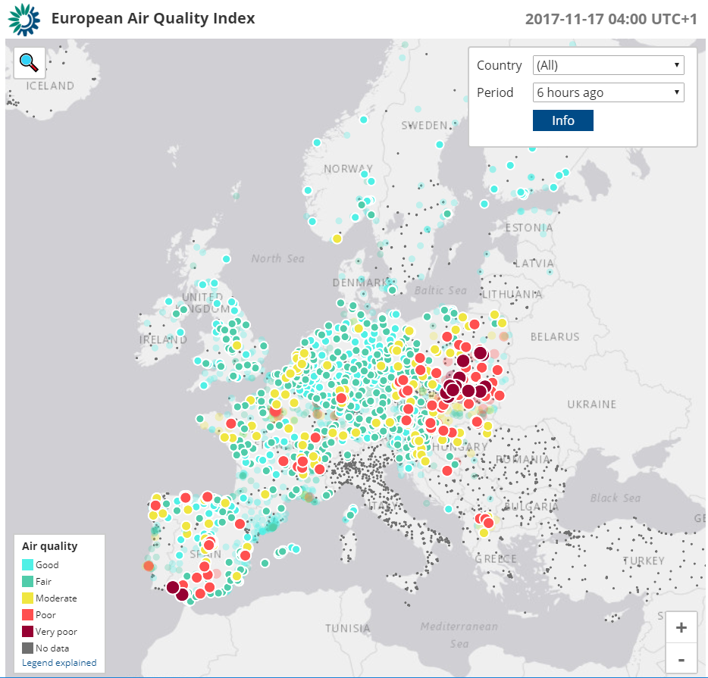
15.4 REPORTING BY AIR QUALITY INDEX
European Union IPA 2013 Programme for Croatia
NEW EUROPEAN AIR QUALITY INDEX
The circles on the map represent air quality monitoring stations.
The color corresponds to the air quality index at a certain hour on that station.
http://airindex.eea.europa.eu/
Institut za energetiku i zaštitu okoliša
Energy Research and Environmental Protection Institute

Slide 40
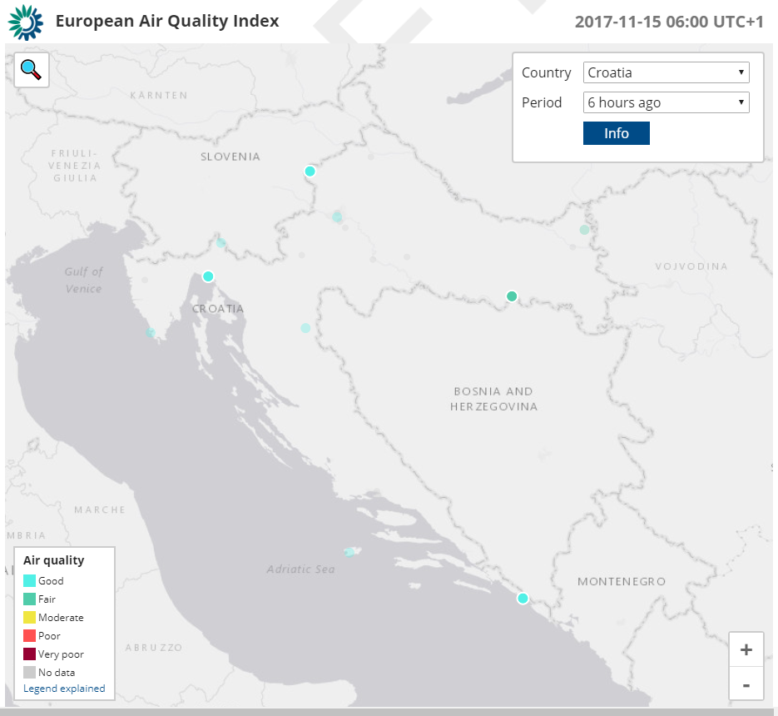
15.4 REPORTING BY AIR QUALITY INDEX
European Union IPA 2013 Programme for Croatia
NEW EUROPEAN AIR QUALITY INDEX
By default settings, the index shows the situation before 6 hours – however, any specific hour can be selected for the last 48 hours.
You can also choose whole Europe or individual country (as in the picture - Croatia)
http://airindex.eea.europa.eu/
Institut za energetiku i zaštitu okoliša
Energy Research and Environmental Protection Institute

Slide 41
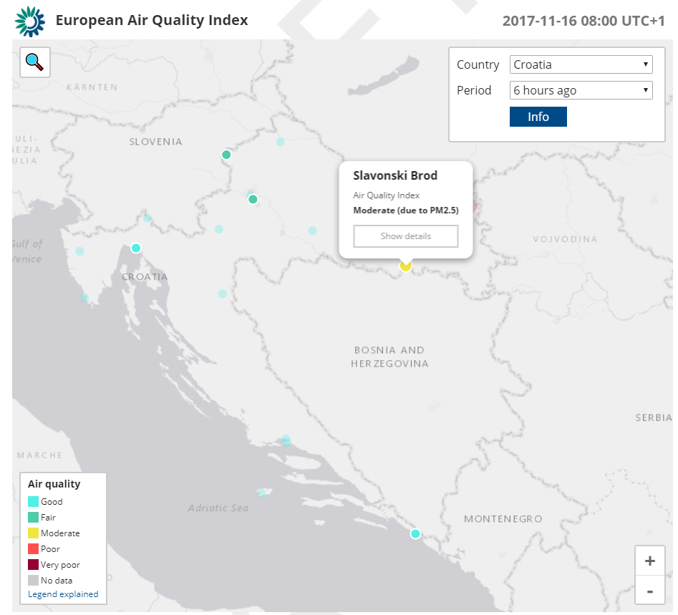
15.4 REPORTING BY AIR QUALITY INDEX
European Union IPA 2013 Programme for Croatia
NEW EUROPEAN AIR QUALITY INDEX
Clicking on a particular monitoring station (circle) will show the pollutant that determines the highest total index level
http://airindex.eea.europa.eu/
Institut za energetiku i zaštitu okoliša
Energy Research and Environmental Protection Institute

Slide 42
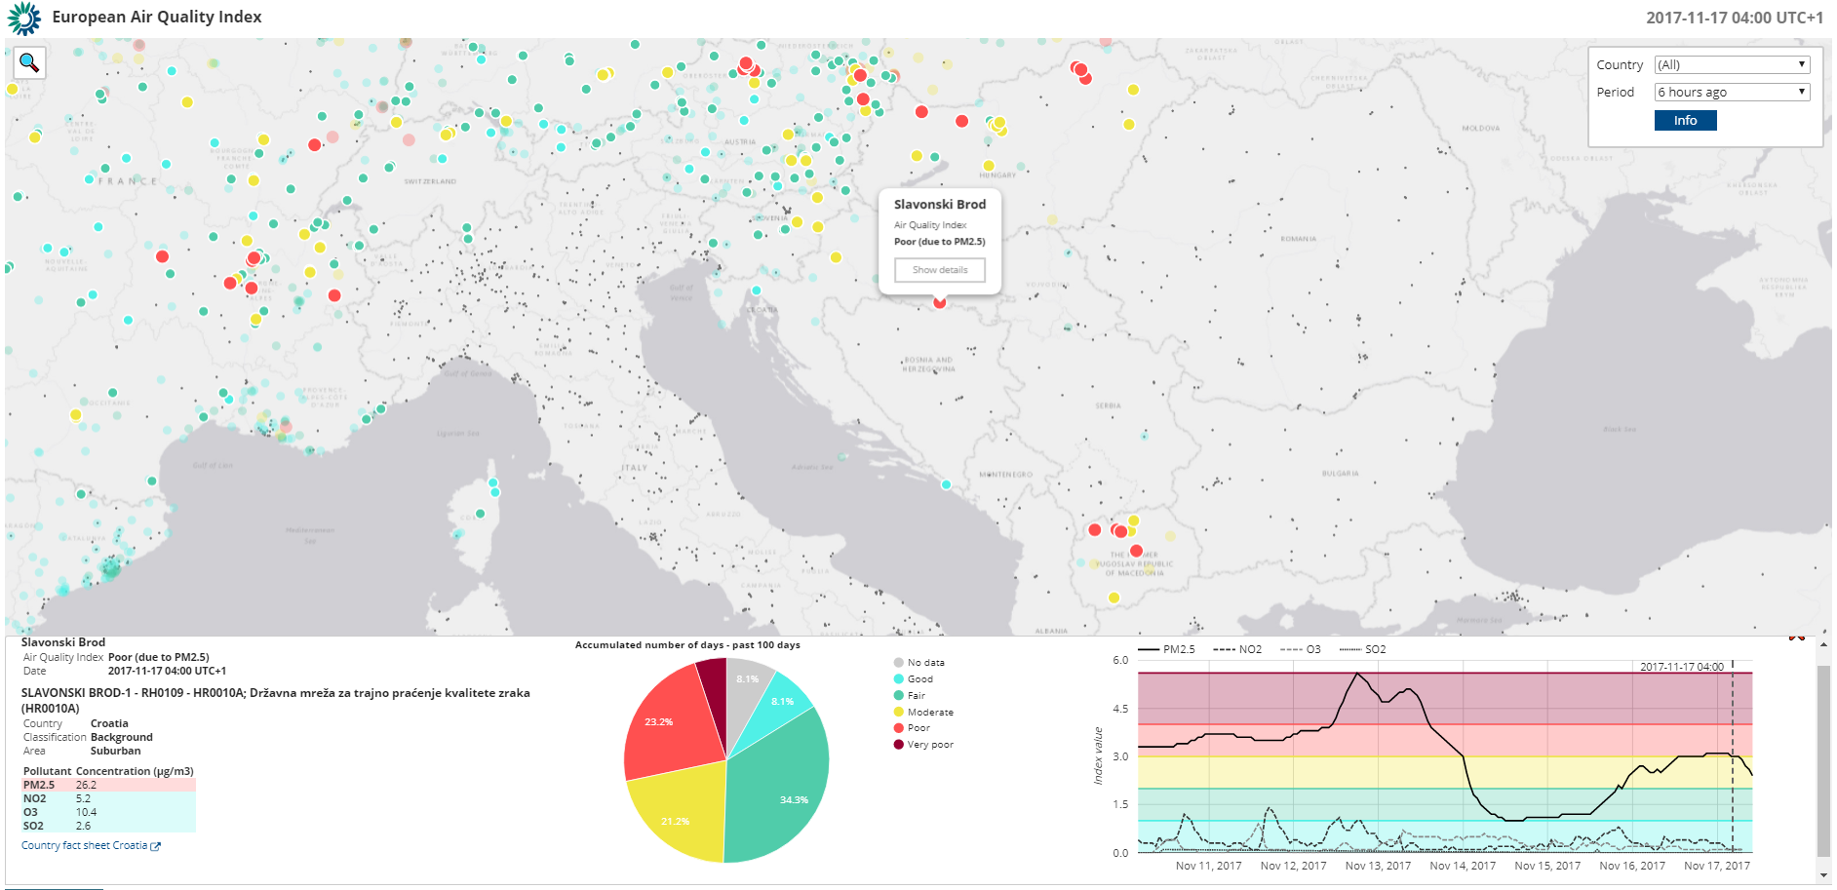
15.4 REPORTING BY AIR QUALITY INDEX
European Union IPA 2013 Programme for Croatia
By clicking on show the details - the basic station information, pollutant concentrations, a graph with index value share in the last hundred days and a graph of index values for each substance in the last week are shown.
Institut za energetiku i zaštitu okoliša
Energy Research and Environmental Protection Institute

Slide 43
15.4 REPORTING BY AIR QUALITY INDEX
European Union IPA 2013 Programme for Croatia
The index uses "updated" air quality data officially delivered every hour from European Economic Area Member States.
There are three color schemes that provide information about the status of data on each monitoring station:
Full color: Minimum number of data required to calculate the index is met
Semi-transparent color: Minimum number of data required for calculating the index is not satisfied - color indicates the air quality index that is calculated only for available pollutants
Gray: There is not enough data to calculate the index.
Institut za energetiku i zaštitu okoliša
Energy Research and Environmental Protection Institute

Slide 44
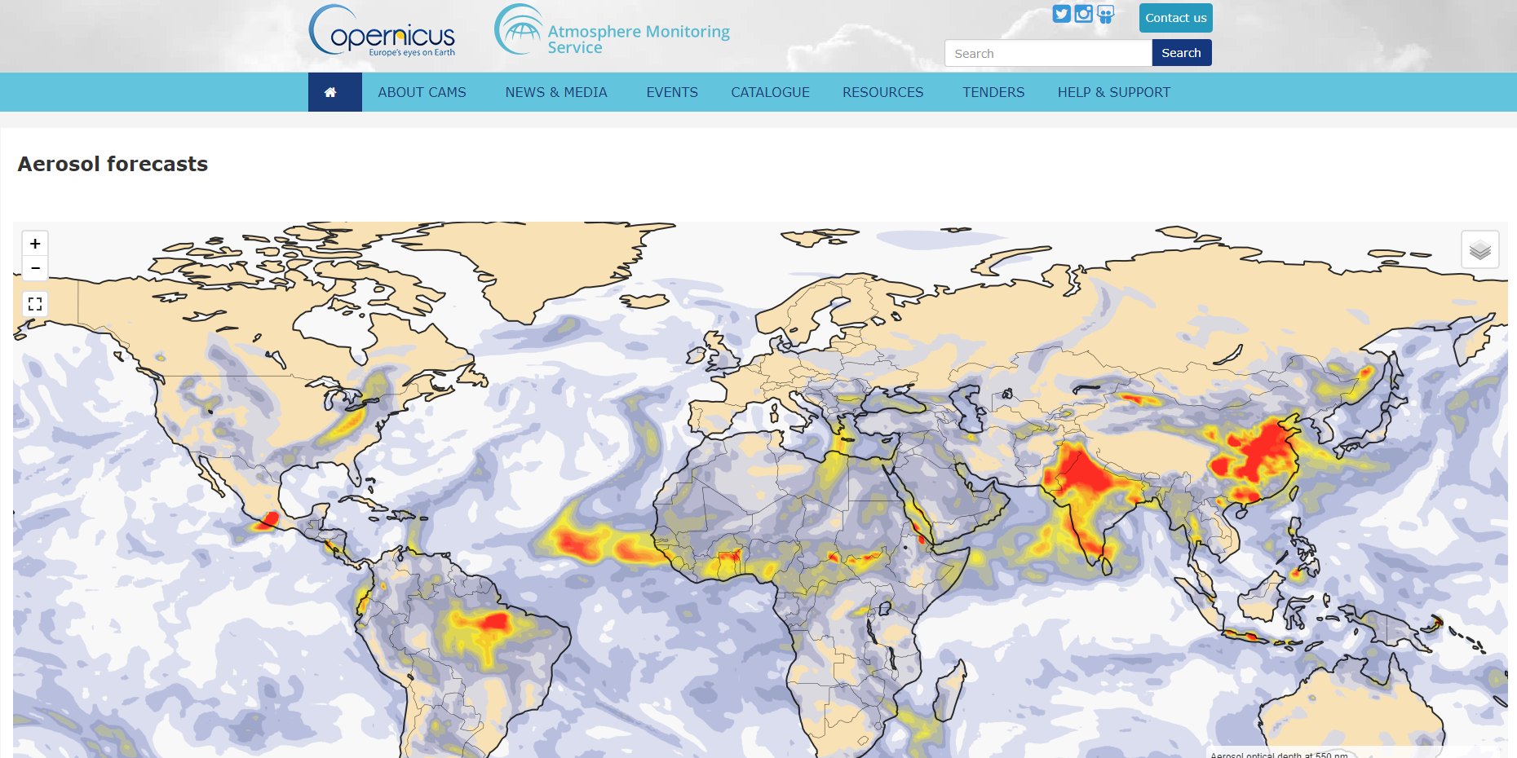
15.4 REPORTING BY AIR QUALITY INDEX
European Union IPA 2013 Programme for Croatia
Air quality measurement data are supplemented with modeled air quality data from the Copernicus Atmospheric Monitoring Service (CAMS) as needed.
http://atmosphere.copernicus.eu/
Institut za energetiku i zaštitu okoliša
Energy Research and Environmental Protection Institute

Slide 45
15.4 REPORTING BY AIR QUALITY INDEX
European Union IPA 2013 Programme for Croatia
Copernicus is a program of the European Union aimed at developing European information services based on satellite observations.
The program is coordinated and managed by the European Commission. It was implemented in partnership with Member States, the European Space Agency (ESA), the European Organization for Exploitation of Meteorological Satellites (EUMETSAT), the European Center for Medium-Range Weather Forecasts (ECMWF), EU Agencies and Mercator Océan.
Large amounts of global data obtained from satellites, field, airborne and maritime measuring systems are used to provide information that would help service providers, public bodies, and other international organizations to improve the quality of life of Europe's citizens.
Information services provided are publicly available to their users.
Institut za energetiku i zaštitu okoliša
Energy Research and Environmental Protection Institute

Slide 46
15.4 REPORTING BY AIR QUALITY INDEX
European Union IPA 2013 Programme for Croatia
Index methodology
If data is not recorded for a particular hour, the values are approximated ("filling in the gap") using CAMS modeled dana on air quality. In such cases, they are clearly labeled within the index as 'modeled data'.
The gap filling method depends on the pollutant, i.e.,
- for NO₂, PM_{2,5} and PM₁₀ using the difference method;
- for O₃ using a multiplicative method;
- for SO₂ there is no filling.
Institut za energetiku i zaštitu okoliša
Energy Research and Environmental Protection Institute

Slide 47
15.4 REPORTING BY AIR QUALITY INDEX
European Union IPA 2013 Programme for Croatia
Index methodology
Difference Method: The value is approximated by taking the CAMS modeled value and adding or subtracting the difference in the correction. This correction is the average difference between the previously measured values and the CAMS modeled value for the same hour for at least three of the previous four days.
Multiplicative Method: The value is approximated by taking CAMS modeled values and applying correction factors. This correction is the average ratio between the previously measured values and the CAMS modeled values for the same hour for at least three of the previous four days.
In cases where there are no measured values for the same hour over three of the previous four days, the index value for this pollutant is not counted and is marked as 'no data'.
Institut za energetiku i zaštitu okoliša
Energy Research and Environmental Protection Institute

Slide 48
15.4 REPORTING BY AIR QUALITY INDEX
European Union IPA 2013 Programme for Croatia
POLLUTION | INDEKS RANGE | POLLUTANT CONCENTRATIONS (µg/m³)
 |  | NO₂ | PM₁₀ |  | O₃ | PM_{2.5} |  | CO | SO₂
 |  | 1hour | 1 hour | 24 hours | 1 hour | 1 hour | 24 hours | 8-hour | 1 hour
VERY HIGH | >100 | >400 | >180 | >100 | >240 | >110 | >60 | >20000 | >500
HIGH | 100 | 400 | 180 | 100 | 240 | 110 | 60 | 20000 | 500
 | 75 | 200 | 90 | 50 | 180 | 55 | 30 | 10000 | 350
MEDIUM | 75 | 200 | 90 | 50 | 180 | 55 | 30 | 10000 | 350
 | 50 | 100 | 50 | 30 | 120 | 30 | 20 | 7500 | 100
LOW | 50 | 100 | 50 | 30 | 120 | 30 | 20 | 7500 | 100
 | 25 | 50 | 25 | 15 | 60 | 15 | 10 | 5000 | 50
VERY LOW | 25 | 50 | 25 | 15 | 60 | 15 | 10 | 5000 | 50
 | 0 | 0 | 0 | 0 | 0 | 0 | 0 | 0 | 0
Comparison of index levels, color and pollutants that are included in the calculation of the index:
CAQI
and new
European AQI
Pollutant |  |  | Particles smaller than 2.5 µm (PM_{2.5}) | Particles smaller than 10 µm (PM₁₀) | Nitrogen dioxide (NO₂) | Ozone (O₃) | Sulfur dioxide (SO₂)
Index level | (based on pollutant concentrations in μg / m³) | Good | 0-10 | 0-20 | 0-40 | 0-80 | 0-100
 |  | Acceptable | 10-20 | 20-35 | 40-100 | 80-120 | 100-200
 |  | Moderate | 20-25 | 35-50 | 100-200 | 120-180 | 200-350
 |  | Poor | 25-50 | 50-100 | 200-400 | 180-240 | 350-500
 |  | Very poor | 50-800 | 100-1200 | 400-1000 | 240-600 | 500-1250
Institut za energetiku i zaštitu okoliša
Energy Research and Environmental Protection Institute

Slide 49
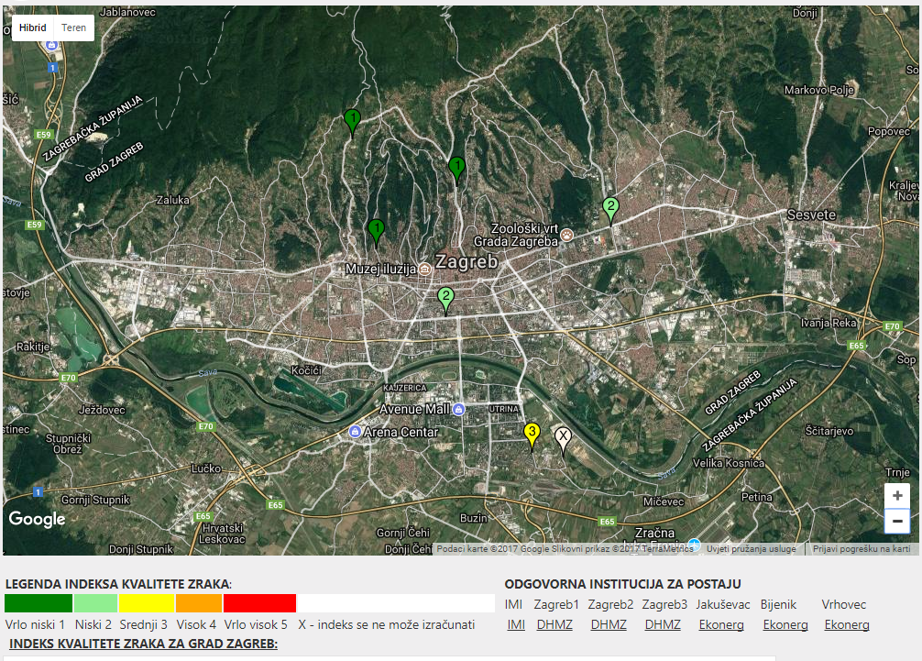
15.5 EXAMPLES
European Union IPA 2013 Programme for Croatia
City of Zagreb
On the Institute for Medical Research and Occupational Health websites there is an overview for the City of Zagreb through the same index of CAQI - as well as on the pages of the Croatian Agency for Environment and Nature.
https://zrak.imi.hr/
Institut za energetiku i zaštitu okoliša
Energy Research and Environmental Protection Institute

Slide 50
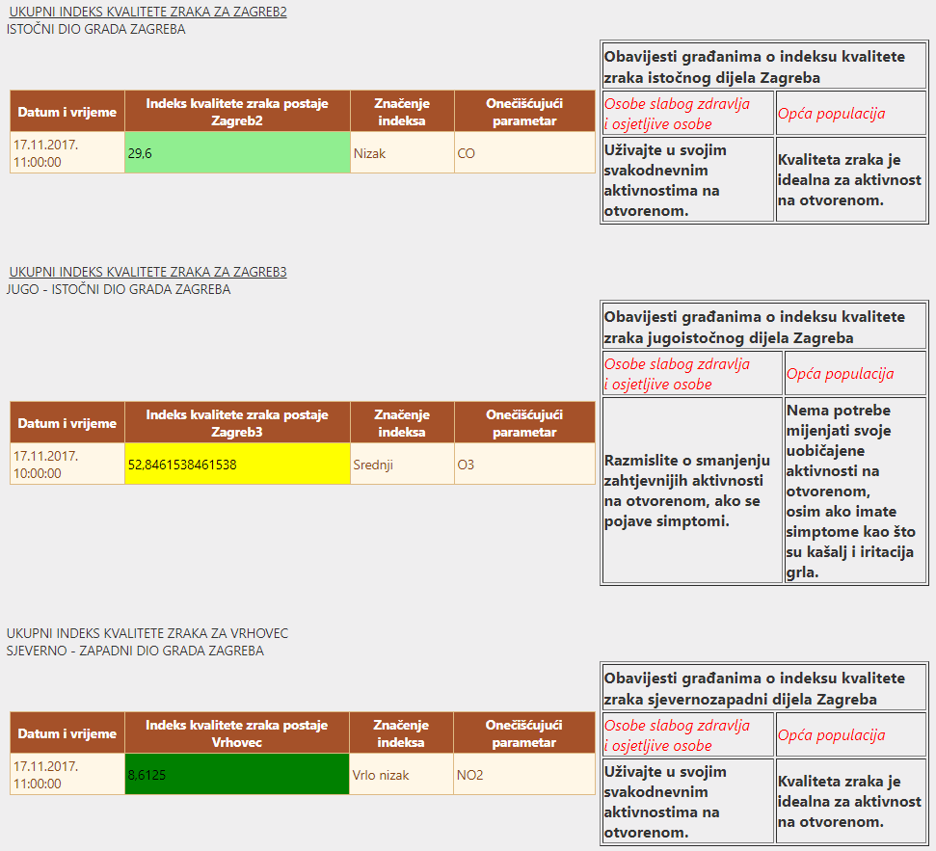
15.5 EXAMPLES
European Union IPA 2013 Programme for Croatia
City of Zagreb
Notifications to citizens on the Air Quality Index have additionally been added - for parts of the city where the station is located for people with poor health and at-risk population as well as general population
https://zrak.imi.hr/
Institut za energetiku i zaštitu okoliša
Energy Research and Environmental Protection Institute

Slide 51
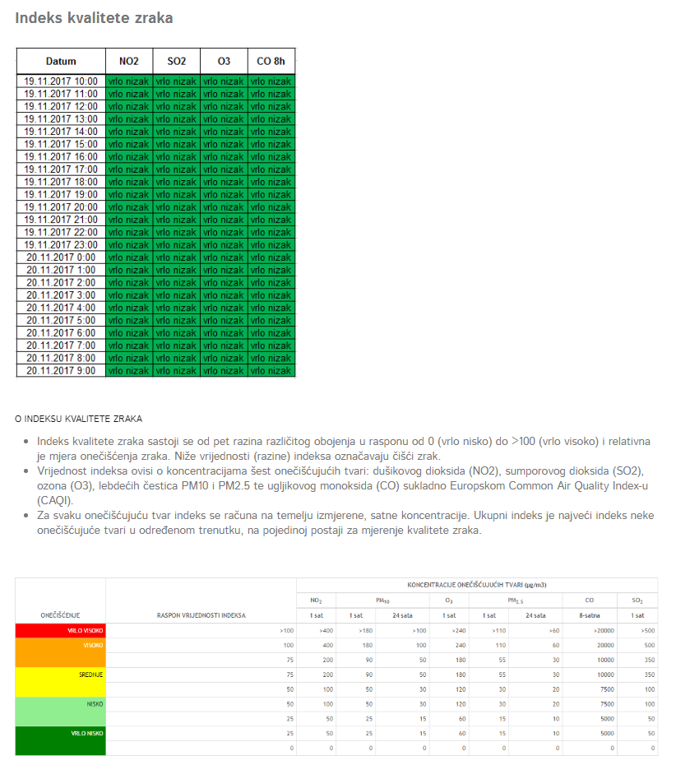
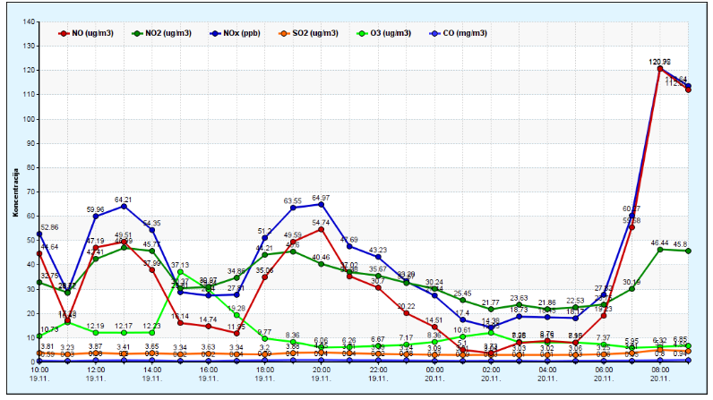
15.5 EXAMPLES
European Union IPA 2013 Programme for Croatia
On the web sites of Andrija Štampar Teaching Institute of Public Health/ Air Quality in the city of Zagreb, concentrations of pollutants measured at the station Mirogojska cesta 16 and index levels according to CAQI indexation are also shown
http://www.stampar.hr/hr/kakvoca-zraka-u-gradu-zagrebu
Institut za energetiku i zaštitu okoliša
Energy Research and Environmental Protection Institute

Slide 52
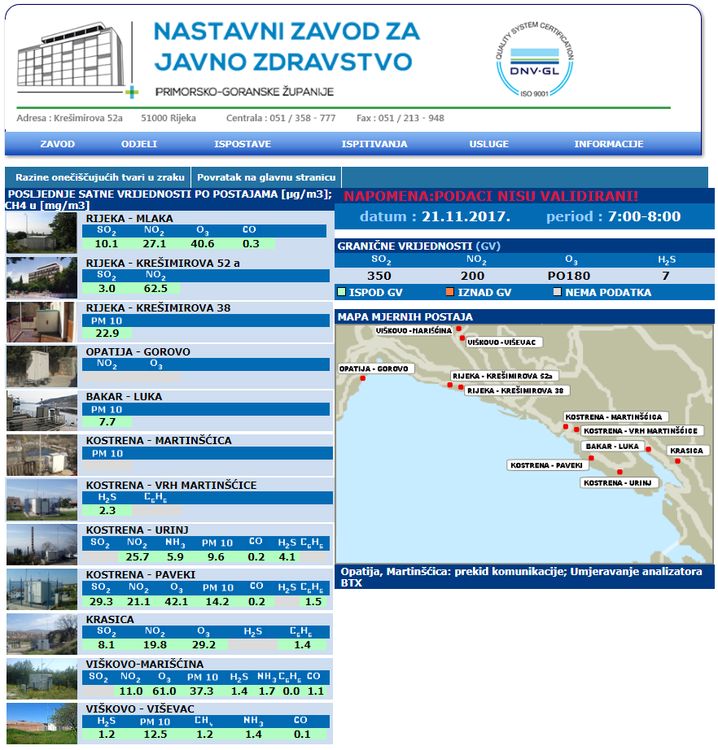
15.5 EXAMPLES
European Union IPA 2013 Programme for Croatia
Only the concentrations of pollutants are shown on the web sites of Teaching Institute of Public Health of Primorsko-goranska County - no display via index
http://www.zzjzpgz.hr/zrak/
Institut za energetiku i zaštitu okoliša
Energy Research and Environmental Protection Institute

Slide 53
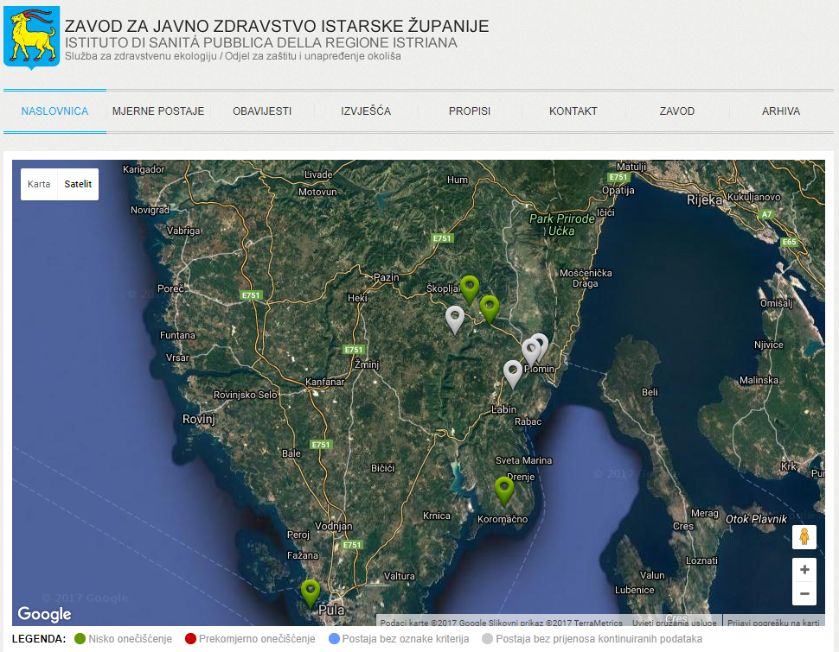
15.5 EXAMPLES
European Union IPA 2013 Programme for Croatia
Only the concentrations of pollutants are shown on the web sites of Teaching Institute of Public Health of Istarska County - no display via index
http://zrak.zzjziz.hr/
Institut za energetiku i zaštitu okoliša
Energy Research and Environmental Protection Institute

Slide 54
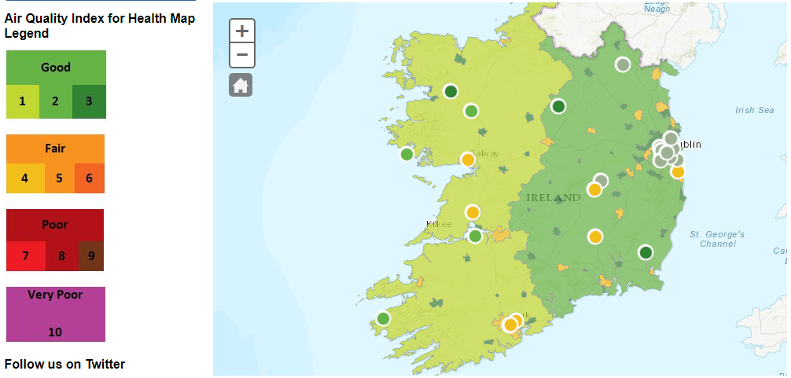
15.5 EXAMPLES
European Union IPA 2013 Programme for Croatia
Ireland - the whole regions (zones) and cities (agglomerations) are colored by the index color. Monitoring stations in indexing colour can also be displayed optionally. The index differs from CAQI. http://www.epa.ie/air/quality/
Institut za energetiku i zaštitu okoliša
Energy Research and Environmental Protection Institute

Slide 55
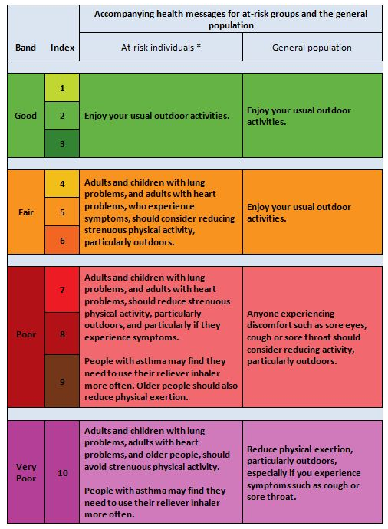
15.5 EXAMPLES
European Union IPA 2013 Programme for Croatia
Ireland
- Explanation of index levels with health message
Institut za energetiku i zaštitu okoliša
Energy Research and Environmental Protection Institute

Slide 56
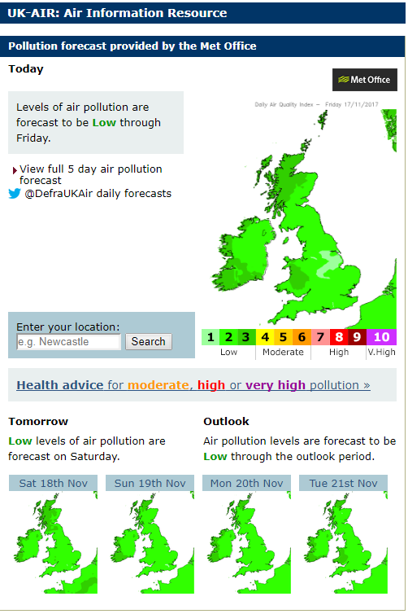
15.5 EXAMPLES
European Union IPA 2013 Programme for Croatia
Great Britain
- Forecast of index levels for the next five days
https://uk-air.defra.gov.uk/
Institut za energetiku i zaštitu okoliša
Energy Research and Environmental Protection Institute

Slide 57
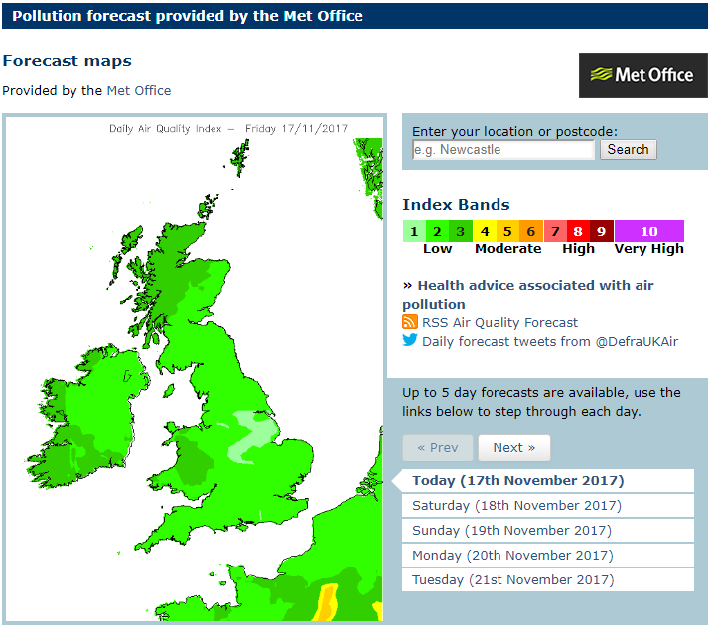
15.5 EXAMPLES
European Union IPA 2013 Programme for Croatia
Great Britain
- Forecast of index levels for the next five days
https://uk-air.defra.gov.uk/
https://uk-air.defra.gov.uk/forecasting/
Institut za energetiku i zaštitu okoliša
Energy Research and Environmental Protection Institute

Slide 58
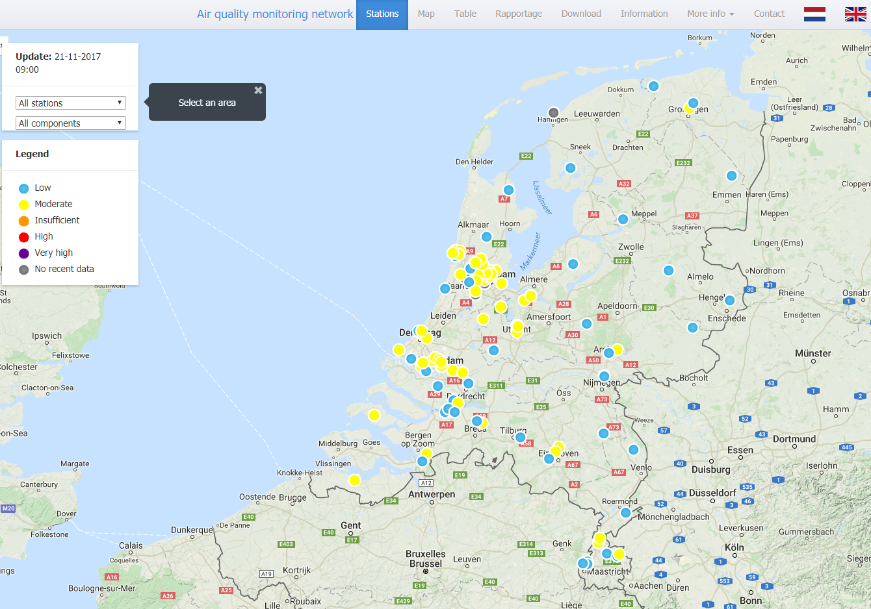
15.5 EXAMPLES
European Union IPA 2013 Programme for Croatia
Netherlands
- Indexation with display of monitoring stations in index colour
https://www.luchtmeetnet.nl/
Institut za energetiku i zaštitu okoliša
Energy Research and Environmental Protection Institute

Slide 59
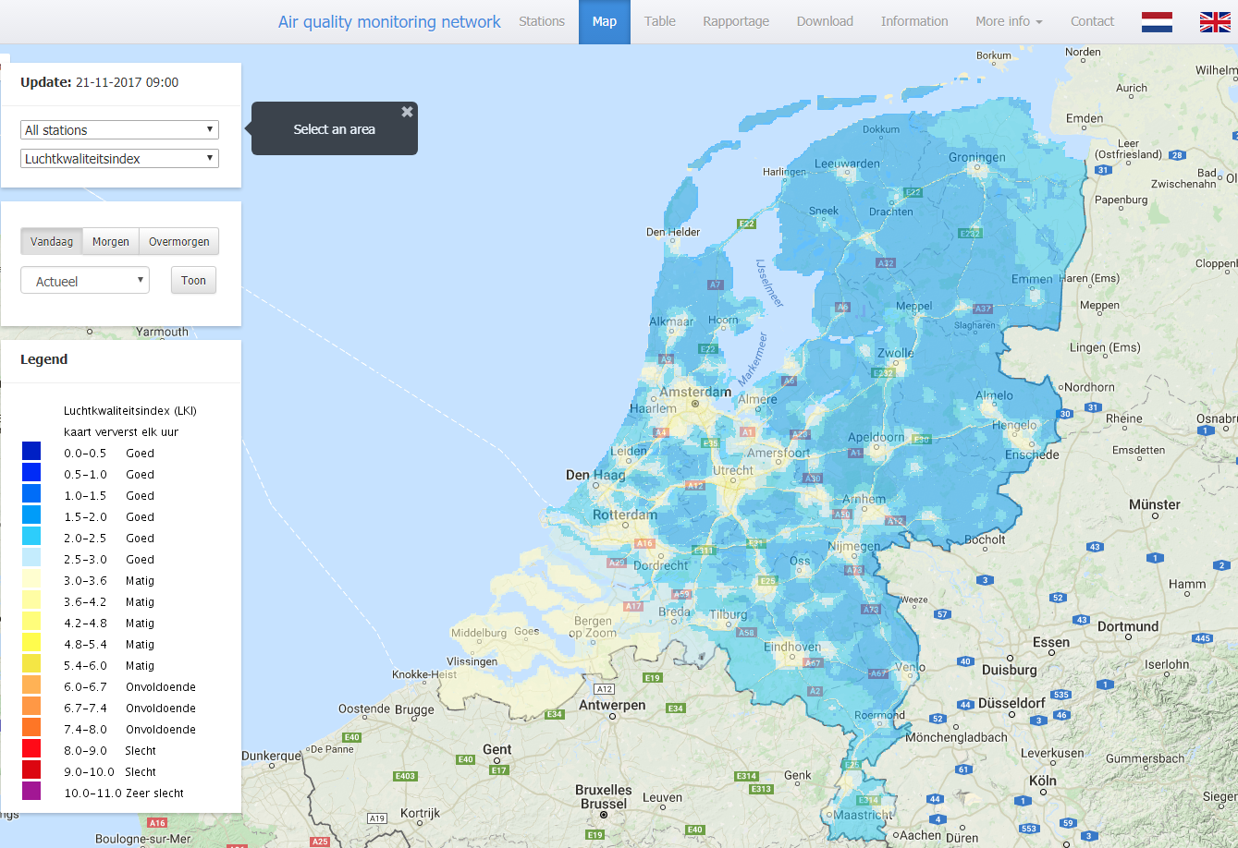
15.5 EXAMPLES
European Union IPA 2013 Programme for Croatia
Netherlands
- -A cartographic view can also be seen - with the air quality forecast up to two days in advance
https://www.luchtmeetnet.nl/kaart
Institut za energetiku i zaštitu okoliša
Energy Research and Environmental Protection Institute

Slide 60
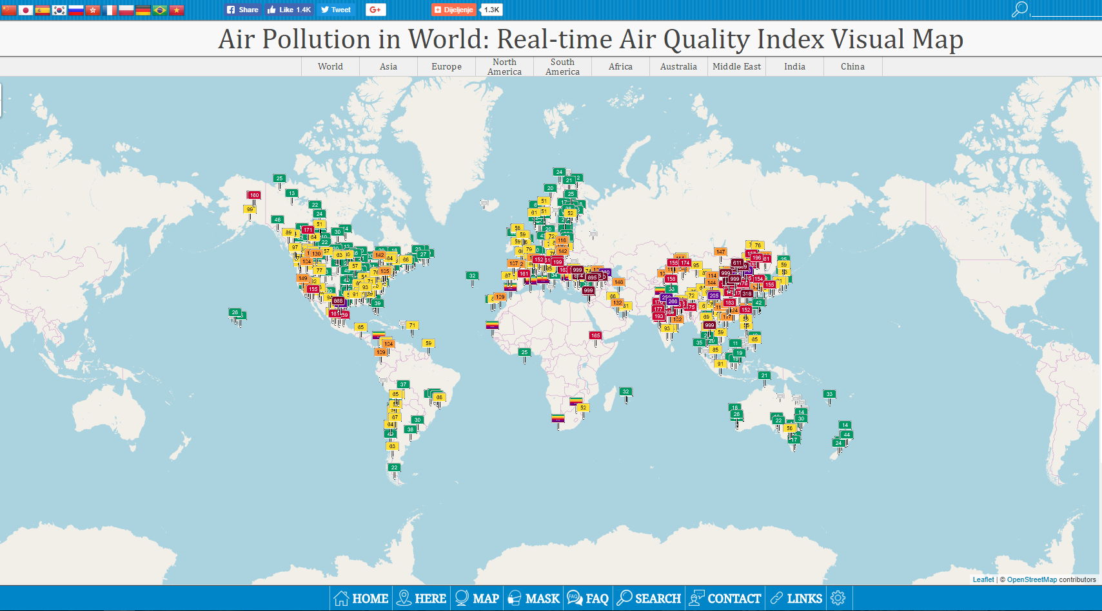
15.5 EXAMPLES
World – display of air quality index in the world– multilingual selection option http://aqicn.org/map/world/
Institut za energetiku i zaštitu okoliša
Energy Research and Environmental Protection Institute

Slide 61
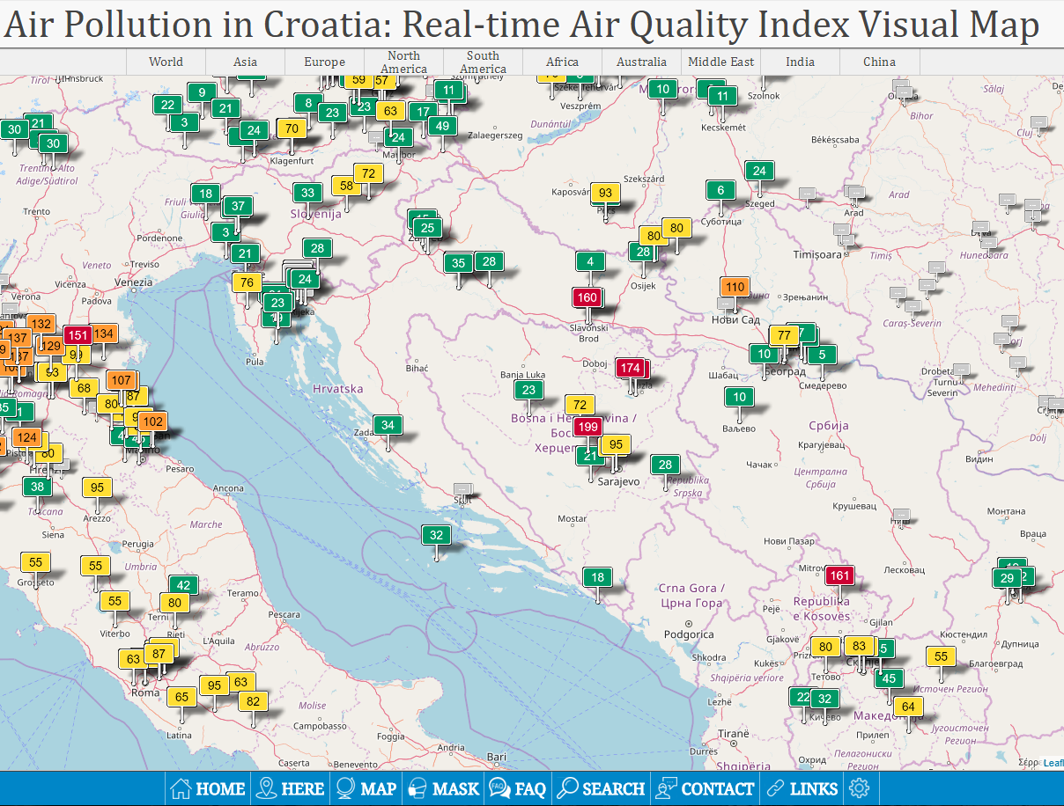
15.5 EXAMPLES
European Union IPA 2013 Programme for Croatia
World
Chinese web site- option to select a country, a region, a continent
http://aqicn.org/map/croatia/#@g/44.183/16.2872/7z
Institut za energetiku i zaštitu okoliša
Energy Research and Environmental Protection Institute

Slide 62
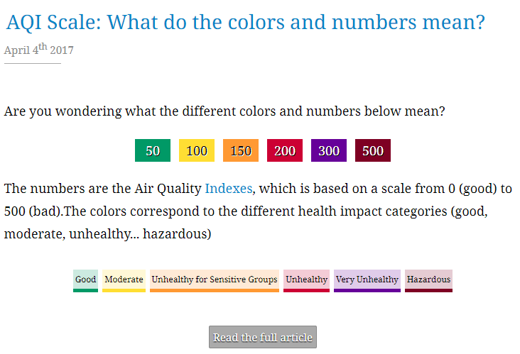
15.5 EXAMPLES
European Union IPA 2013 Programme for Croatia
World
Chinese web site- option to select a country, a region, a continent
http://aqicn.org/faq/
Institut za energetiku i zaštitu okoliša
Energy Research and Environmental Protection Institute

Slide 63
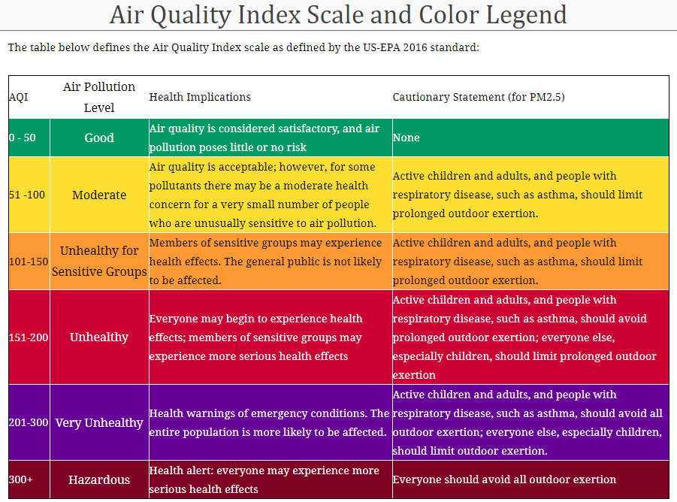
15.5 EXAMPLES
European Union IPA 2013 Programme for Croatia
World
Chinese web site- option to select a country, a region, a continent
http://aqicn.org/scale/
Institut za energetiku i zaštitu okoliša
Energy Research and Environmental Protection Institute

Slide 64
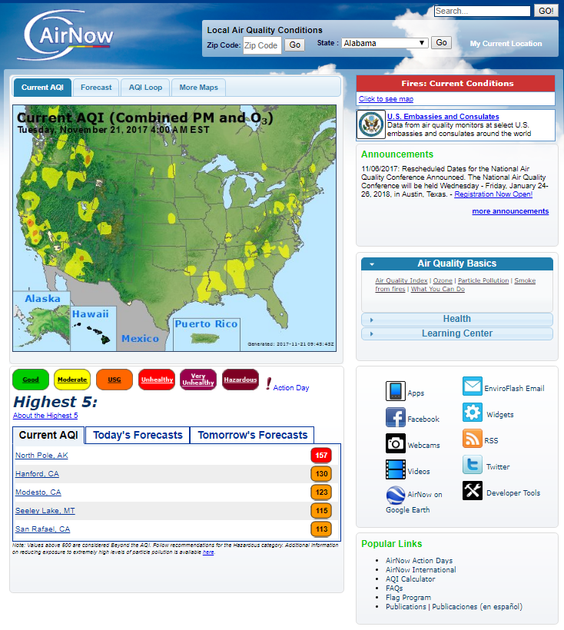
15.5 EXAMPLES
European Union IPA 2013 Programme for Croatia
USA
The Air Quality Index on the EPA (Environmental Protection Agency) website
https://www3.epa.gov/airnow/aqi_brochure_02_14.pdf
Institut za energetiku i zaštitu okoliša
Energy Research and Environmental Protection Institute

Slide 65
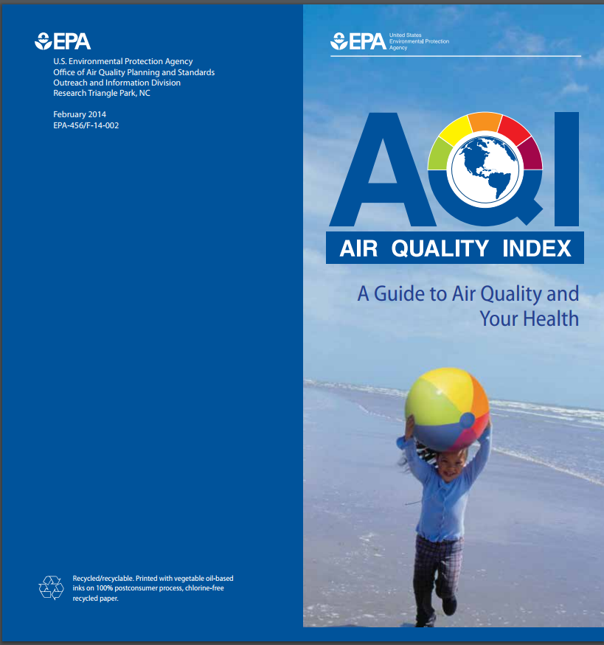
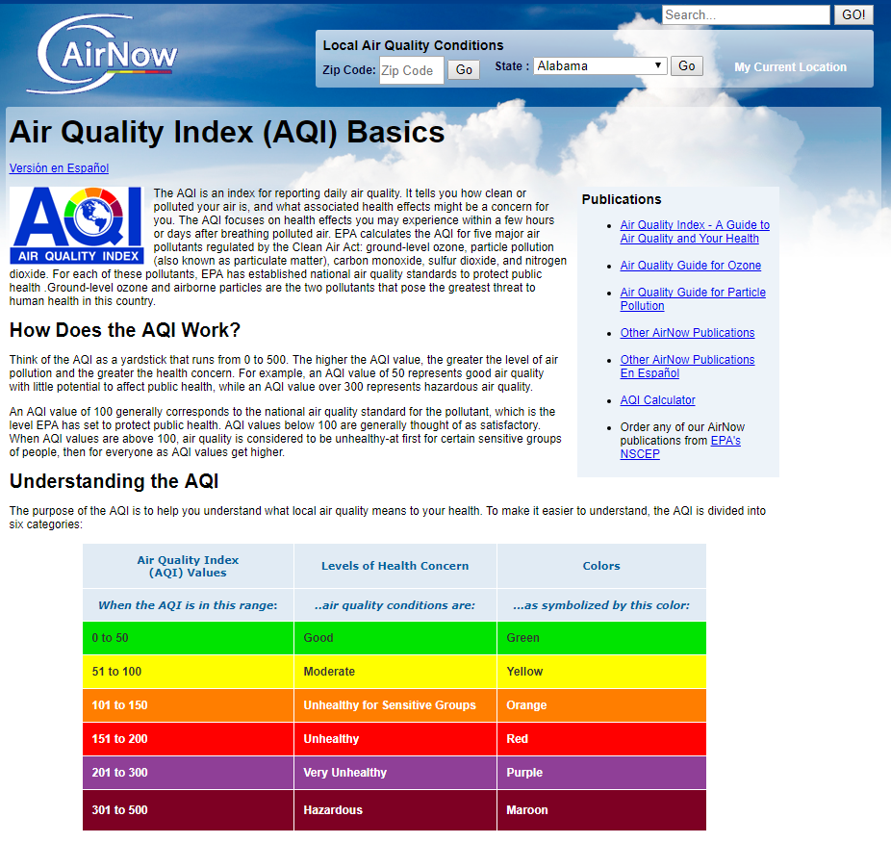
15.5 EXAMPLES
European Union IPA 2013 Programme for Croatia
USA
- Indexation legend
https://airnow.gov/index.cfm?action=aqibasics.aqi
https://www3.epa.gov/airnow/aqi_brochure_02_14.pdf
Institut za energetiku i zaštitu okoliša
Energy Research and Environmental Protection Institute

Slide 66
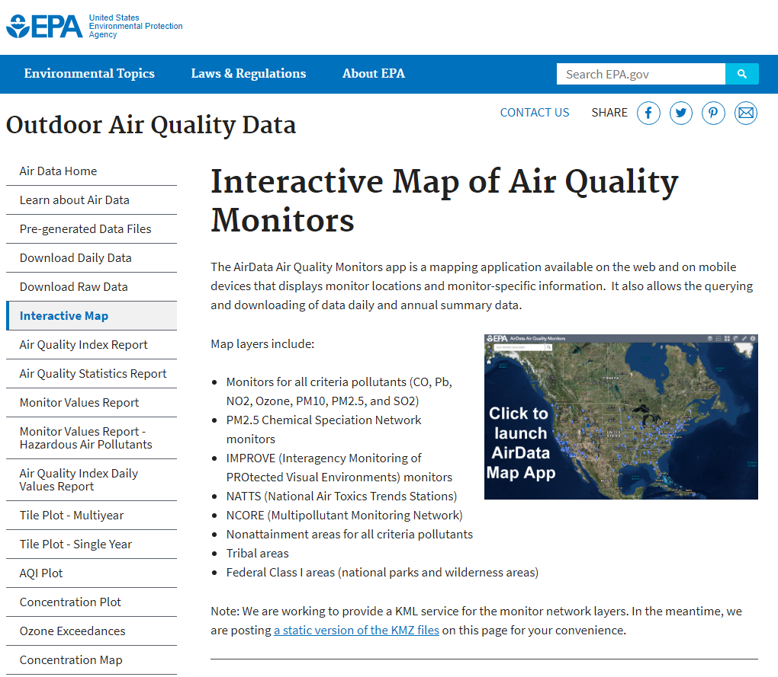
15.5 EXAMPLES
European Union IPA 2013 Programme for Croatia
USA - EPA
Interactive air quality data map
https://www.epa.gov/outdoor-air-quality-data/interactive-map-air-quality-monitors
Institut za energetiku i zaštitu okoliša
Energy Research and Environmental Protection Institute

Slide 67
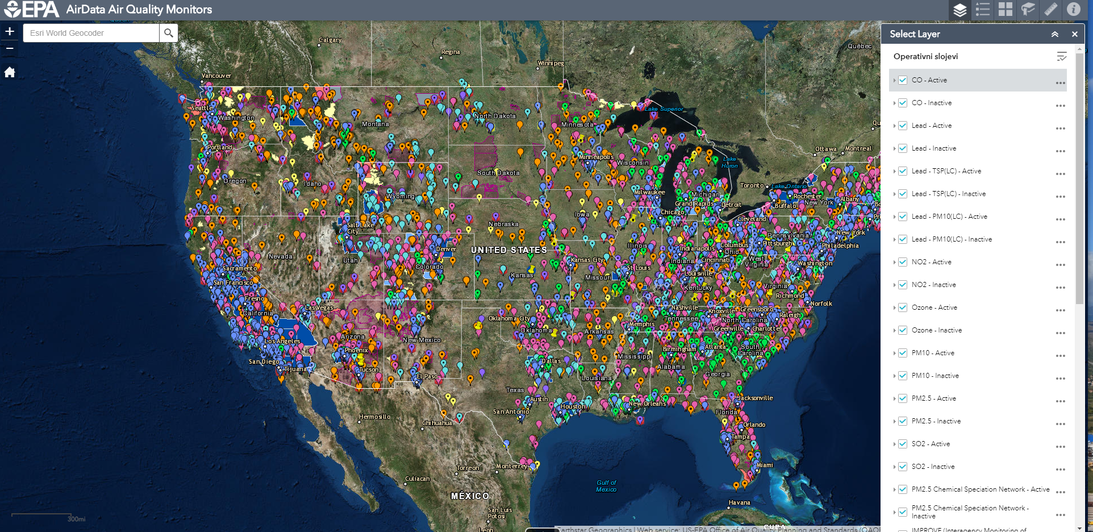
15.5 EXAMPLES
European Union IPA 2013 Programme for Croatia
USA – option to add all individual layers on the map....
https://epa.maps.arcgis.com/apps/webappviewer/index.html?id=5f239fd3e72f424f98ef3d5def547eb5&extent=-146.2334,13.1913,-46.3896,56.5319
Institut za energetiku i zaštitu okoliša

Slide 68
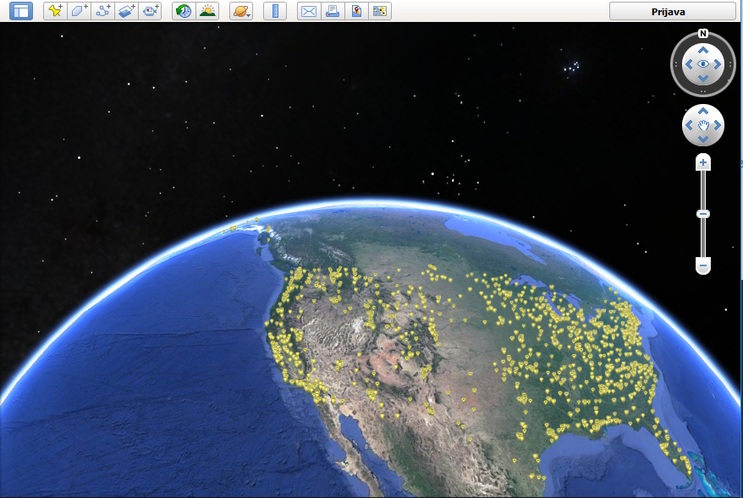
15.5 EXAMPLES
European Union IPA 2013 Programme for Croatia
USA
Viewing is possible also through Google Earth App....
Institut za energetiku i zaštitu okoliša
Energy Research and Environmental Protection Institute

Slide 69
THANK YOU FOR YOUR ATTENTION
Energy Research and Environmental Protection Institute
Disclaimer: The contents of this publication are the sole responsibility of EKONERG – Energy Research and Environmental Protection Institute, Ltd. and can in no way be taken to reflect the views of the European Union
This project is funded by the European Union

